Slide 1
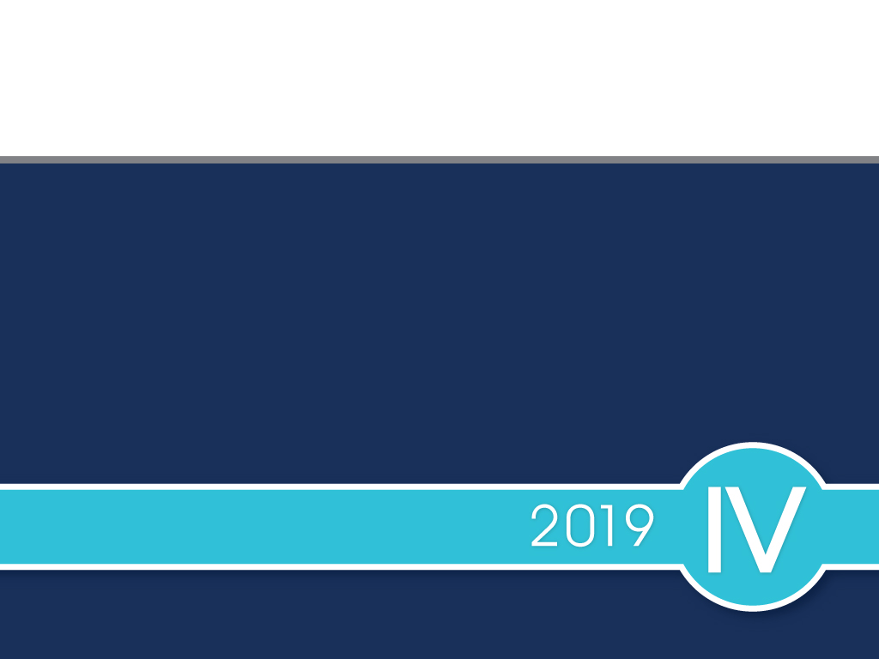
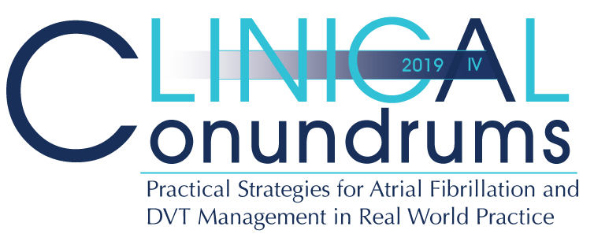

Slide 2

Presenter Disclosure
Presenter - [presenter name]
Relationships with financial sponsors:
Grants/Research Support:
Speakers Bureau/Honoraria:
Consulting Fees:
Patents:
Other:
Notes:
Speaker Notes:

Slide 3
Disclosure of Financial Support
This program has received financial support from BMS and Pfizer Alliance Canada in the form of an educational grant.
This program has received in-kind support from BMS and Pfizer Alliance Canada in the form of logistical support.
Potential for conflict(s) of interest:
[Presenter] has received [payment/funding, etc.] from [organization supporting this program AND/OR organization whose product(s) are being discussed in this program].
BMS and Pfizer Alliance Canada Canada developed, licenses, distributes and benefits from the sale of a product that will be discussed in this program
Notes:
Speaker Notes:

Slide 4
Mitigating Potential Bias
The Canadian Heart Research Centre (CHRC) assesses conflict of interest with its instructors, planners, managers and other individuals who are in a position to control the content of CME activities. All relevant conflicts of interest that are identified are thoroughly vetted by the CHRC for fair balance, scientific objectivity of studies utilized in this program, and patient care recommendations. The CHRC is committed to providing its learners with high quality CME activities and related materials that promote improvements or quality in healthcare and not a specific proprietary business interest of a commercial interest.
The speaker had provided a full disclosure in advance of the program. The scientific content of the program is evidence based and all content related to pharmacotherapy is within product label. The program has been peer reviewed and is nationally accredited by the College of Family Physicians of Canada.
[Presenter] has provided his disclosure information at the start of this presentation.
Notes:
Speaker Notes:

Slide 5

Program Development
This program was planned by the Canadian Heart Research Centre, a not-for-profit academic organization to achieve scientific integrity, objectivity, and balance.
This program has received an educational grant and in-kind support from BMS and Pfizer Alliance Canada
Notes:
Speaker Notes:

Slide 6
Steering Committee
George Honos, MD Clinical Conundrums Program Chair
Cardiologist Chief of cardiology Medical Director of CV Program, CHUM Associate Professor of Medicine, Université de Montréal Montreal, Quebec
Jacques Bouchard MD
Associate professor of clinical medicine
Université Laval , Québec
Head medicine department
Hôpital de la Malbaie . Québec
Paul Dorian, MD Cardiologist Director, Division of Cardiology Professor of Medicine St. Michael's Hospital University of Toronto Toronto, Ontario
Indy (Indraneel) Ghosh, MD
Assistant Clinical Professor, McMaster University
Emergency Physician at Trillium Health Partners
Shaun Goodman, MD
Associate Head, Division of Cardiology, St. Michael's Hospital
Professor and Heart & Stroke Foundation of Ontario (Polo) Chair, Department of Medicine, University of Toronto
Adjunct Professor, Department of Medicine, University of Alberta
Jeffrey Habert, MD
Family Physician Assistant Professor
University of Toronto
Dept. of Family and Community Medicine Toronto, Ontario
Sylvain Lanthier, MD
Neurologist Neurovascular Program, CHUM
Associate Professor, University of Montreal Montreal, Quebec
John K. Marshall, MD
Professor of Medicine, and
Director, Division of Gastroenterology
McMaster University
Hamilton Ontario
L. Brent Mitchell, MD
Cardiac Electrophysiologist
Professor, Department of Cardiac Sciences
Libin Cardiovascular Institute of Alberta
University of Calgary Calgary, Alberta
Daniel Ngui, MD
Family Physician Clinical Lead, Fraser Street Medical
Clinical Associate Professor
UBC Department of Family Medicine Vancouver, British Columbia
Isabelle Noiseux, MD
Directrice adjointe à la direction de la formation professionnelle
FMOQ
Faisal Rehman, MD
Professor of Medicine
Schulich School of Medicine
Western University
Notes:
Speaker Notes:

Slide 7

Learning Objectives
Upon completion of this activity, participants should be able to:
I
Select personalized treatment options for stroke prevention in atrial fibrillation using current Canadian Practice Guidelines supplemented with reassuring “Real World” experience
II
Assess and optimize bleeding risk of atrial fibrillation patients requiring long-term DOAC stroke prevention treatment
III
Recognize the current treatment gap in Canada and take steps at ensuring appropriate dosage selection and long-term compliance with oral anticoagulation among AF patients

Slide 8

1 in 3 strokes after age 65 are attributed to AF
20% of patients die and another 60% have major disability after an embolic stroke
Despite anticoagulation being an effective treatment in AF, stroke prevention is slow to reflect evidence-based practice.
Real-world data reveal that a substantial portion of AF patients who would benefit from anticoagulation do not receive it adequately.
A large part of this suboptimal treatment is due to the underutilization and incorrect dosing of direct oral anticoagulants (DOACs).
Canadian Journal of Cardiology 34 (2018) 1412e1425
Notes:
Speaker Notes:

Slide 9
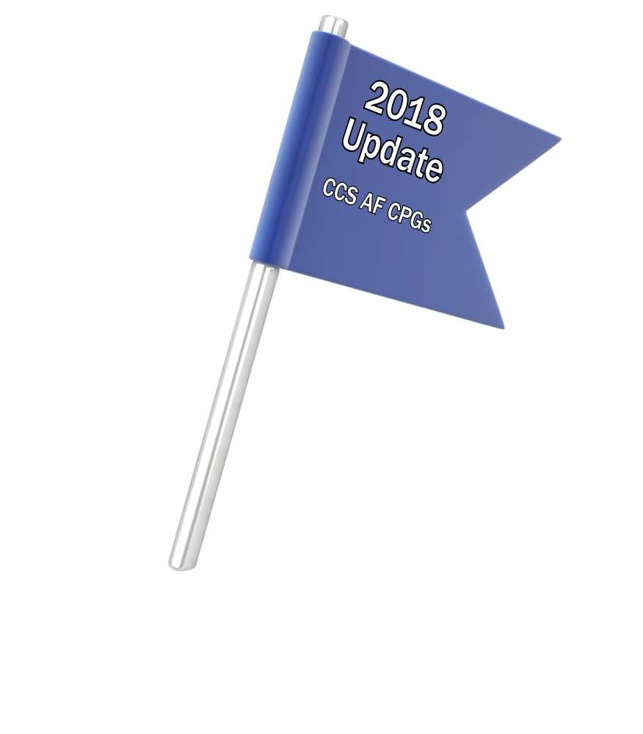
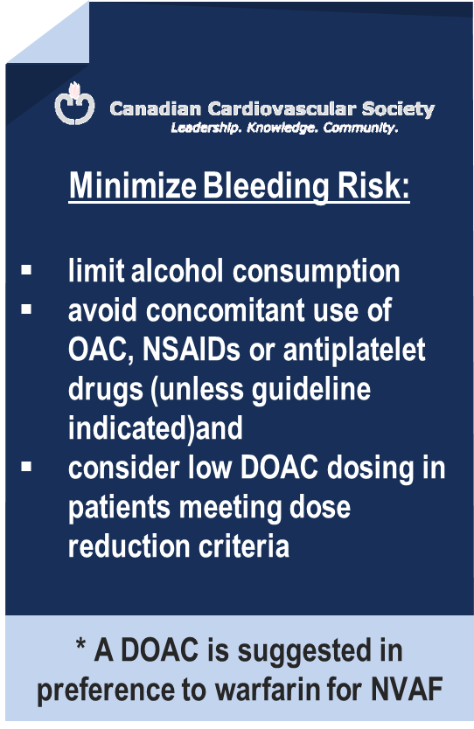
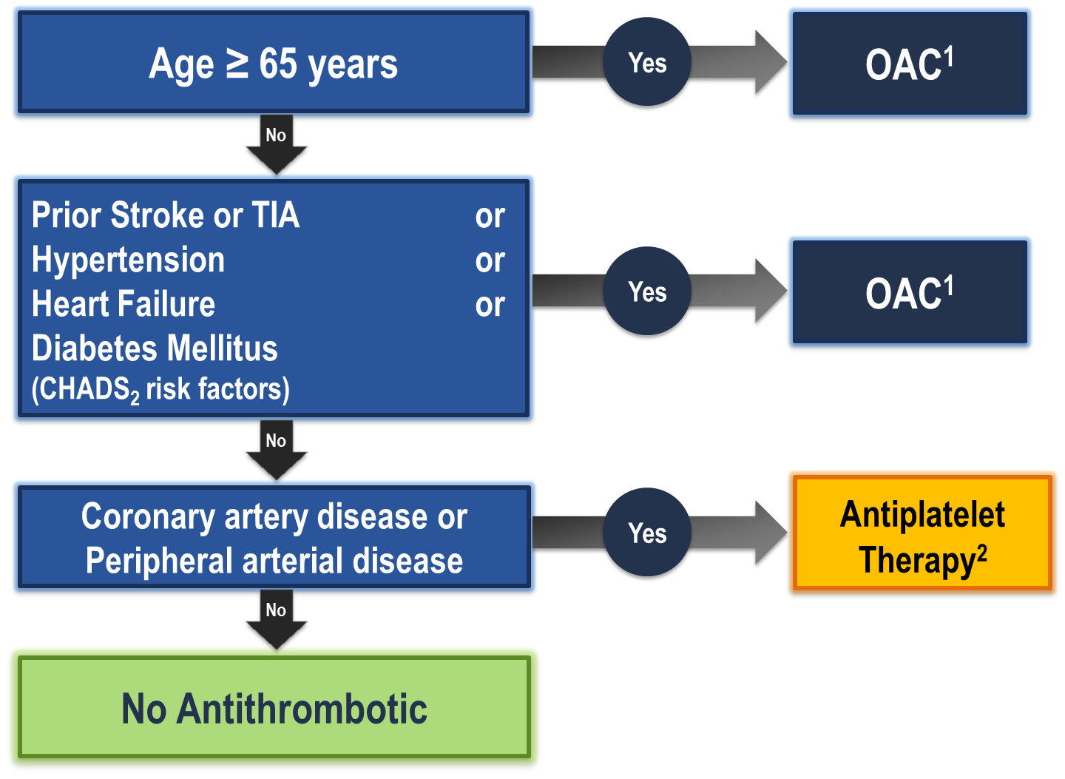
The “CCS Algorithm” (CHADS-65) for OAC Therapy in AF
¹ A DOAC is preferred over warfarin in non-valvular AF
² Therapeutic options include single antiplatelet therapy (ASA 81-100 mg daily) alone; or in combination with either a second antiplatelet agent (e.g. clopidogrel 75 mg daily or ticagrelor 60 mg BID), or an antithrombotic agent (rivaroxaban 2.5 mg BID)
Andrade JG et al. Can J Cardiol 2018;34:1371-1392
CCS AF Guidelines. Can J Cardiol. 2016; 32: 1170-1185
Notes:
Speaker Notes:
This is the new and important slide from the 2018 (box to the right is from the 2016 update) Canadian AF guidelines update.
Two key points to emphasize: the (*) indicates that a DOAC should be selected in preference to an AVK for anticoagulation. The shaded box to the right emphasizes that all efforts should be made to select the correct DOAC dosage based on age, size and renal function as well as to minimize the bleeding risk by addressing any modifiable bleeding risk factors present.
There is no longer any need to calculate a patient’s HASBLED score as this does not influence management (most patients are antioagulated even, if at higher bleeding risk..)
Canada has not adopted the CHADSVASC scoring system to determine eligibility for oral anticoagulation in AF. The annual embolic stroke risk threshold for anticoagulation is set at 1.5% and it is felt that a vascular diseased patient who is aged 64 or less and CHADS2 = 0 has an annual stroke risk of less than 1.5% based on the Canadian Guideline Committee’s interpretation of currently available large data sets.

Slide 10
Operational Definition of Non Valvular Atrial Fibrillation (NVAF)
“Valvular” AF includes :
Mechanical heart valve
Rheumatic moderate or severe mitral valve stenosis (MS) *
NVAF (“ non-valvular” AF) therefore includes :
Mitral regurgitation (MR)
Aortic stenosis (AS)
Aortic insufficiency (AI)
Remote (3-6 months) tissue prosthetic heart valve
Remote (3-6 months) surgical valve repair
* It is uncertain whether patients with only mild MS or post mitral commissurotomy should be regarded as “Valvular” AF.
Macle L et al. Can J Cardiol 31:1207-18, 2015
De Caterina R, et al. Eur Hear J 2014;35:3328-35
Notes:
Speaker Notes:
MDs need to be reminded that NVAF applies to patients WITHOUT a mechanical heart valve prosthesis OR rheumatic mitral valve disease (a relative rarity in Canada these days). Patients with ALL other forms of valvular heart disease, including valvular bioprostheses, qualify as NVAF!

Slide 11
DOACs vs Warfarin RCTs Baseline Characteristics
 | RE-LYª ^{(Dabigatran)} | ROCKET-AF^{b} ^{(Rivaroxaban)} | ARISTOTLE^{c} ^{(Apixaban)} | ENGAGE AF^{d} ^{(Edoxaban)}
Randomized, N | 18,113 | 14,264 | 18,201 | 21,105
Age, y | 72±9 | 73 [65-78] | 70 [63-76] | 72 [64-78]
Female, % | 37 | 40 | 35 | 38
Paroxysmal AF, % | 32 | 18 | 15 | 25
VKA naive, % | 50 | 38 | 43 | 41
Aspirin use, % | 40 | 36 | 31 | 29
CHADS 2
0-1
2
3-6
Connolly SJ, et al. N Engl J Med. 2009;361:1139-1151^{[3];}
Patel MR, et al. N Engl J Med. 2011;365:883-891^{[4];}
Granger CB, et al. N Engl J Med. 2011;365:981-992^{[5];}
Giuliano RP, et al. N Engl J Med. 2013;369:2093-2104.^{[6}
Notes:
Speaker Notes:
Over 70,000 patients have been prospectively studied with the different DOACs compared to warfarin (but not to each other.
Average age was over 70 in each trial (AF is an arrhythmia of the elderly). Co-morbidities and therefore treatment conundrums are very common!
Women represented up to 40% of subjects randomized in these trials (for once well represented with results applicable to them)!
ASA use was allowed in each trial if indicated according to the investigator (up to 40% of patients were on concomitant ASA). This allows us to see the important effect of ASA+DOAC or ASA+ warfarin on bleeding risk and underscores the importance of stopping ASA (and NSAIDs) whenever possible when prescribing a DOAC
The trials randomized AF patients with a broad range of annual stroke and systemic embolism risk based on their CHADS2 score. Two of the four trials randomized patients at lower CHADS2 0-1 risk wjile the other two focused on AF patients at higher annual risk. This has clear implications when attempting to compare efficacy and safety results of DOACs vs warfarin using indirect comparisons and meta-analyses.

Slide 12
DOACs as Compared to Warfarin Indirect Comparisons from the Clinical Trials
 | Apixaban¹ | Dabigatran 110² | Dabigatran 150² | EDOXABAN 60 | Rivaroxaban³
Stroke/SE
Major Bleed
Intracranial Bleed
GI Bleed
All Cause Death
To date there are no head-to-head trials between apixaban, dabigatran, edoxaban and rivaroxaban, therefore comparative efficacy and safety have not been established
Significant Increase
Significant Reduction
Non Significant Difference
Granger et al., NEJM 2011; 365: 981-992
Connolly et al., NEJM 2009; 361: 1139-1151
Patel et al., NEJM 2011; 365: 883-891
Giuliano RP et al NEJM 2013; 369:2091
Notes:
Speaker Notes:
This slide shows some key efficacy and safety outcome data vs. warfarin from the four major DOAC trials: RE-LY, ROCKET, ARISTOTLE and ENGAGE
Apixaban and Dabigatran 150 mg were associated with significant reduction of stroke/SE vs. warfarin.
Apixaban, Dabigatran 110 mg and Edoxaban were associated with significant reduction of major bleeding vs. warfarin.
All DOACs were associated with a significant reduction of intracranial bleeding (ICH) compared to warfarin.
Dabigatran 150 mg, Edoxaban and Rivaroxaban were associated with an increase in GI bleeding vs. warfarin.
Apixaban is associated with a significant reduction in mortality compared to warfarin.
Definition of major bleeding:
RE-LY: a reduction in the hemoglobin level of at least 20 g per liter, transfusion of at least 2 units of blood, or symptomatic bleeding in a critical area or organ.
ROCKET: as clinically overt bleeding associated with any of the following: fatal outcome, involving a critical site (i.e., intracranial, intraspinal, intraocular, pericardial, intraarticular, intramuscular with compartment syndrome, or retroperitoneal), or clinically overt bleeding associated with a fall in hemoglobin concentration of ≥ 2 g/dL, or leading to transfusion of ≥ 2 units of packed red blood cells or whole blood.
ARISTOTLE: clinically overt bleeding accompanied by a decrease in the hemoglobin level of at least 2 g per deciliter or transfusion of at least 2 units of packed red cells, occurring at a critical site, or resulting in death.
ENGAGE: International Society of Thrombosis and Hemostasis definition : clinically overt bleeding accompanied by a decrease in the hemoglobin level of at least 2 g per deciliter or transfusion of at least 2 units of packed red cells, occurring at a critical site, or resulting in death.
References:
﻿Connolly SJ, et al; for the RE-LY Steering Committee and Investigators. Dabigatran versus warfarin in patients with atrial fibrillation. N Engl J Med 2009; 361:1139-1151.
Connolly SJ, et al; for the RE-LY Investigators. Newly identified events in the RE-LY trial. N Engl J Med 2010; 363(19):1875-1876.
Patel MR, et al; and the ROCKET AF Steering Committee for the ROCKET AF Investigators. Rivaroxaban versus warfarin in nonvalvular atrial fibrillation. N Engl J Med 2011; 365:883-891.
Granger CB, et al; for the ARISTOTLE Committees and Investigators. Apixaban versus warfarin in patients with atrial fibrillation. N Engl J Med 2011; 365:981-992.

Slide 13
Stroke Prevention in AF: Clinical Pharmacology and Dosing of DOACs
 | Apixaban | Dabigatran | EDOXABAN | Rivaroxaban
Mechanism of action | Direct Factor Xa inhibitor | Direct thrombin inhibitor | Direct Factor Xa inhibitor | Direct Factor Xa inhibitor
Oral bioavailability | ~50% | ~6.5% | 62% | 80-100%
Pro-drug | No | Yes | No | No
Food effect | No | No | No | Yes (needs to be taken with food)
Renal clearance | ~27% | 85% | 50% | 36% *
Mean half-life (t_{1/2}) | ~12 h | 11-17h | 10-14h | 5-13 h
T_{max} | 3-4 h | 0.5-2 h | 1-2h | 2-4 h
Recommended daily dose | 5 mg BID | 150 mg BID | 60 mg QD | 20 mg QD
Pfizer Canada Inc./BMS Canada. Eliquis (apixaban) Product Monograph, June 16, 2016.
Boehringer Ingelheim Canada Ltd. Pradaxa (dagbatran) Product Monograph. August 11, 2016.
Bayer Inc. Xarelto (rivaroxaban) Product Monograph. July 20, 2015.
Daiichi Sankyp Inc. Lixiana (edoxaban) Product Monograph. November 2, 2016.
* Rivaroxaban is 66% renally cleared and its active metabolite is 36% renally cleared
Notes:
Speaker Notes:
DOACs can be differentiated based on efficacy and bleeding risk in the clinical trials ( and real-world experience available and forthcoming…) with the limitations of indirect clinical comparisons duly acknowledged. DOACs can also be differentiated based on other factors as summarized in this slide. Parameters such as borderline renal function, sensitivity to dyspepsia, irregular food intake, need for blister pack medication preparation by pharmacist, cognitive dysfunction and medication non compliance to BID dosing etc etc can determine selection of the best agent for a given patient!
The Tmax of all DOACs is a short 2-4 hours. This means that, unlike with warfarin, a patient is rapidly anticoagulated within just two hours following a DOAC dose. This has important implications for heparin “bridging” which is no longer required with DOACs as well as for the timing of resumption of DOAC therapy following procedures.
All DOACs share a short 12 hour half-life in the setting of preserved renal function (CrCl > 60 ml/min). This is a major advantage over warfarin which has a half-life of 36 hours or longer depending on hepatic function. Most procedures at intermediate or high bleeding risk can be performed within 1-2 days respectively of withholding a DOAC with additional delay required with renal dysfunction. Moreover, major bleeding can usually be controlled with local and supportive measures as the effect of the DOAC wears off quickly. Specific DOAC antidotes are therefore rarely required.

Slide 14
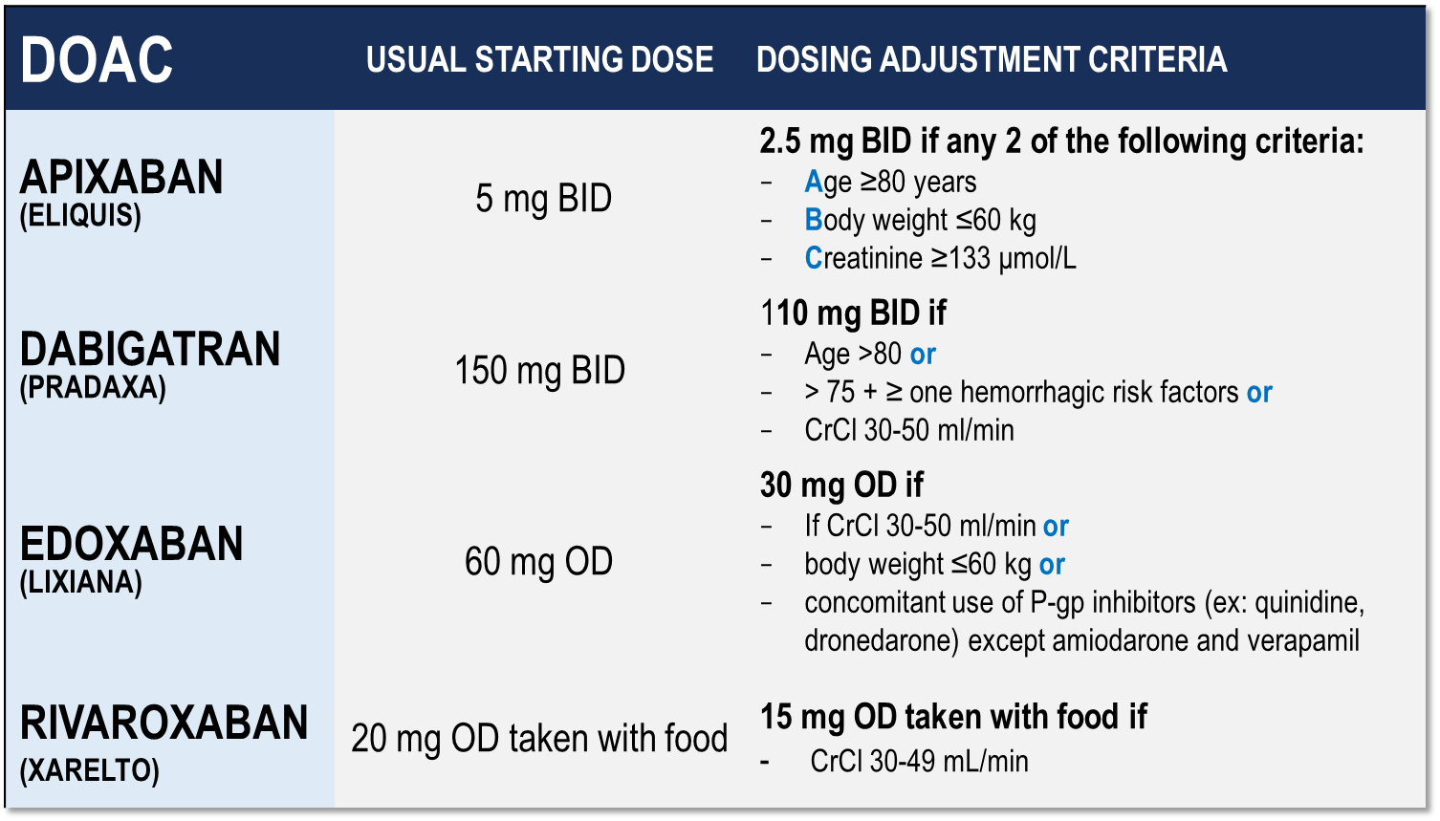
Considerations for Dosing of DOACs
Pfizer Canada Inc./BMS Canada. Eliquis (apixaban) Product Monograph, 2018.
Boehringer Ingelheim Canada Ltd. Pradaxa (dagbatran) Product Monograph. August 11, 2016.
Bayer Inc. Xarelto (rivaroxaban) Product Monograph. 2018.
Daiichi Sankyp Inc. Lixiana (edoxaban) Product Monograph. 2017.
Notes:
Speaker Notes:
Indispensable slide summarizing the criteria for a dosage adjustment from the default higher dosage for the different DOACs currently available in Canada
The dosing adjustments proposed for apixaban, edoxaban and rivaroxaban are those utilized to the dosage of selected patients enrolled in the respective prospective clinical trials (ARISTOTLE, ENGAGE and ROCKET-AF). The overall goal was to achieve a stable plasma concentration in subjects assigned to DOAC therapy in these studies.
The speaker should emphasize that the RELY study, in fact, tested two separate dosages of dabigatran (150 mg and 110 mg BID) independently against warfarin, without a pre-specified dosage reduction algorithm for reduced renal function. Since dabigatran is known to be 85% renally cleared, the Canadian AF Guidelines Committee subsequently proposed dosing adjustments (as did all other guideline committees), as listed in the table, for elderly patients and those with stage 3 renal dysfunction in order to minimize the risk of drug accumulation and bleeding in these patients.

Slide 15
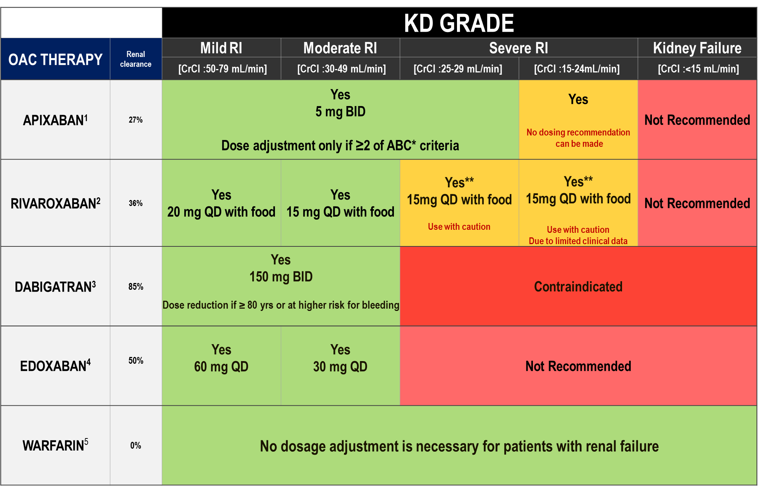
DOAC Dosing Recommendations for Stroke Prevention in AF in Patients with Renal Impairment According to the Canadian Product Monographs
Pfizer Canada Inc./BMS Canada. Eliquis (apixaban) Product Monograph, 2018.
Boehringer Ingelheim Canada Ltd. Pradaxa (dagbatran) Product Monograph. August 11, 2016.
Bayer Inc. Xarelto (rivaroxaban) Product Monograph. 2018.
Daiichi Sankyp Inc. Lixiana (edoxaban) Product Monograph. 2017.
Notes:
Speaker Notes:
*ABC criteria: Dose reduction to 2.5 mg BID if at least 2 of the following: Age ≥ 80, Body weight ≤ 60kg, serum Creatinine ≥ 133 micromol/L (1.5 mg/dL)
**Moderate renal impairment: Use with caution especially in those concomitantly receiving other drugs which increase rivaroxaban plasma concentrations, consider the benefit/risk of anticoagulant therapy before administering rivaroxaban to patients with moderate renal impairment having a creatinine clearance close to the severe renal impairment category (CrCl < 30 mL/min), or in those with a potential to have deterioration of renal function to severe impairment during therapy.
DOAC, non-vitamin K antagonist oral anticoagulant; AF, atrial fibrillation; CrCL, estimated creatinine clearance

Slide 16
DOAC Antidotes
Andexanetª ^{(PRT064445)} | Antidote for factor Xa inhibitors Recombinant protein binding to factor Xa inhibitor site
Aripazine^{b} ^{(PER977)} | Antidote for factor Xa inhibitors, direct thrombin inhibitors, low molecular-weight heparins, and fondaparinux Synthetic small molecule; reversal effect through direct binding to anticoagulant
Idarucizumab^{c} ^{(BI 655075)} | Antidote for direct thrombin inhibitors Fully humanized antibody fragment
a. Clinicaltrials,gov; NCT01758432 16; b Dolgin E. Nat Med. 2013;19:251(17), c, Clinicaltrials.gov;NCT01955720.{18}
Notes:
Speaker Notes:
Key Points:
Idarucizumab (Praxbind™) is approved in the US as well as Canada and is available for rapid dabigatran effect reversal in highly selected situations. These include emergent need for surgery (major trauma), need for thrombolysis for ischemic stroke, and suspected dabigatran overdose)
Andexanet Alpha (AndexXa™) was approved by the FDA in the US in May 2018 but is still awaiting approval by Health Canada at the present time. It is “decoy” Xa recombinant protein that binds to any of the anti-Xa DOACs (apixaban, rivaroxaban, edoxaban) thus sequestering them and interrupting their anticoagulant activity. As with Idarucizumab, a high selective usage is anticipated once approved in this country.
It is important to keep in mind that all DOAC antidotes have the potential of pro-thrombotic complications (eg. MI, ischemic stroke) that can reach a rate of 5% at one month. The benefit-risk of their use should therefore carefully be individualized.

Slide 17

What are the patterns of reduced dose use in Canada?
Notes:
Speaker Notes:

Slide 18
Appropriate Use of Antithrombotic Medications in Canadian Patients with NVAF
7,019 patients with NVAF from 735 primary care physician practices
Over 90% of patients with CHADS₂ >1 receiving oral anticoagulation
BUT ….
Over 50% of patients on OAC taking warfarin
30.9% of patients on warfarin TTR < 65%
Of the patients on DOACs, 11.7% were on the wrong dose
7.4% under-dosed
4.3% over-dosed
Additional 3.2% of patients on DOAC were contraindicated by renal function
NVAF: Non Valvular Atrial Fibrillation
Bell AD, et al. Am J Cardiol. 2016 Apr 1;117(7):1107-11
Notes:
Speaker Notes:

Slide 19
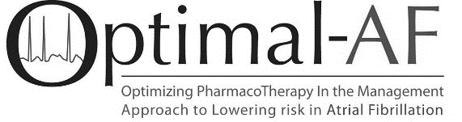
DOAC Dose and Lower Dose Concordance*
Apixaban (n=556⁺)
Dabigatran (n=181⁺)
Rivaroxaban (n=369⁺)
*Concordant with Health Canada Product Monograph prescribing recommendations
⁺Dosing information available
Non-vitamin K antagonist Oral Anticoagulant (NOAC) Use and Dosing in Canadian Practice: Insights from the Optimizing PharmacoTherapy in the Management Approach to Lowering risk in Atrial Fibrillation (OPTIMAL-AF) Program - CCS 2018 Poster Presentation
Notes:
Speaker Notes:
Of the 556 AF patients on Apixaban, 23% were given the reduced dose of 2.5 mg bid of whom about half (13% of the total) did not have 2 of the 3 “ABC” criteria present (age ≥ 80, weight ≤ 60 kg, creatinine ≥ 133)
Of the 181 patients on Dabigatran, 38% were on the reduced dose of 110mg bid and only 4% were felt to be on a dosage that was discordant with current Canadian Guidelines
Of the 369 patients on Rivaroxaban, 18% were on a reduced dose and 8% were felt to have been reduced to 15 mg daily inappropriately.
Overall, the message is that there is some room for improvement through further knowledge dissemination

Slide 20
What are real world data good for?
What are the real-world outcomes in patients receiving DOACs?
Notes:
Speaker Notes:

Slide 21
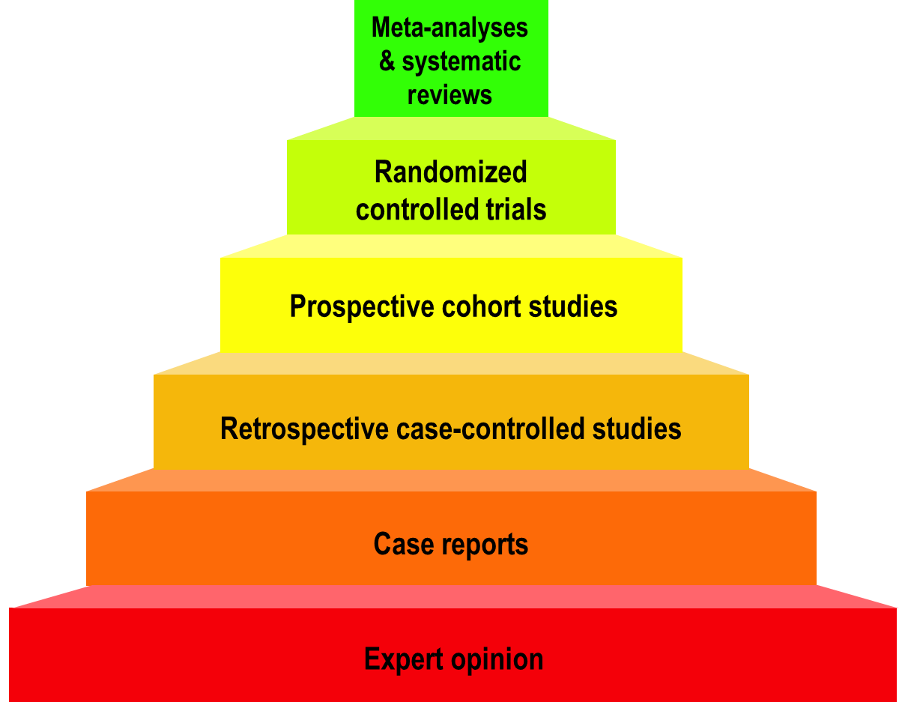
Hierarchy of Medical Evidence
Stronger
Observational
studies
Weaker
Modified from the logicofscience.com
Notes:
Speaker Notes:
It is important to emphasize that randomized controlled trials (RCTs) represent the strongest type of medical evidence to guide management of patients.
Observational studies vary on quality and can be confirmatory and reassuring when results agree with those of RCTs. When there is disagreement with RCTs, observational studies are considered “hypothesis generating” and findings need to be prospectively confirmed by randomized RCTs.

Slide 22

Not Medical Evidence
Patient wishes or testimonials
Celebrity endorsement
Experience with your last patient
Gut feeling
Familial instinct
Information from those who are biased
Modified from the logicofscience.com
Notes:
Speaker Notes:
This slide is self-explanatory and may be used at the speakers discretion to emphasize some of the many barriers we face in ensuring long-term patient compliance to DOACs in a world of “fake-news” and multiple different “opinions” from biased sources who often have a less than scientific personal agenda… Patients (and physicians..) must beware in a world of readily accessible (mis)information!

Slide 23
What are RWD Studies Good for?
Describe how the therapy is being used
Enable comparisons not available from RCTs
Describe outcomes in niche patient populations
Enable subgroup studies for individualized Rx
Unique observations generate hypotheses
Use large samples to identify rare events
NEVER to refute significant RCT findings
Modified from the logicofscience.com
Notes:
Speaker Notes:
This slide can be used to elaborate on comments made to slide 22 and list some of the potential uses of observational RWD studies.

Slide 24
What is “Propensity Score Matching”?
Doctors prescribe different treatments to different kinds of patients (patient characteristics determine their propensity to receive treatment X).
Propensity matching attempts to correct for this difference by matching patients in one group with patients in the other group based on the characteristics defining their propensity to be in one group rather than the other.
Does not correct for every propensity difference.
Modified from the logicofscience.com
Notes:
Speaker Notes:
This slide is useful when describing how non-randomized “big data” is used in Real World studies. Propensity score matching attempts to correct for the absence of prospective randomization when analyzing data retrospectively. Only variables that are available in the dataset can be matched and corrected for leaving plenty of room for unaccounted for bias. This is why propensity score matching can never be as powerful as prospective double blind randomization where groups are generally identical except for the variable (e.g. drug) under investigation.
May be used as a backup slide at the presenter’s discretion

Slide 25
RWD Studies Are Different
STRONGER REAL WORLD DATA | WEAKER REAL WORLD DATA
Prospective; purpose-specific data | Retrospective; convenience data
Propensity matched study populations | Unmatched study populations
Large patient populations | Small patient populations
Representative patient populations | Selected patient populations
Standard outcomes (same as the RCTs) | Unusual outcomes (different than RCTs)
Outcomes for efficacy and safety | Single sided outcomes
Follow-up durations long | Follow-up durations short
Funding independent of industry | Funded by industry
Analysis independent of industry | Analysis by industry
Sensitivity analysis for biases | No sensitivity analysis for biases
TEMPORAL TRENDS AND SAFETY | UNCOMMONLY HELPFUL
Adapted from Dang A, Kaur K. Perspect Clin Res 2016; 7(1): 9-14.
Notes:
Speaker Notes:
Slide compares the strengths and weaknesses of observational real world data, empowering the attendee to better discriminate between the growing number of RWD studies published each year.
Useful adjunct to slide 26 depending on the audience interest in the subject

Slide 26
DOACs as Compared to Warfarin Clinical Trials vs Real World Data (RWD)
 | Apixaban Aristotle Study¹ | RWD⁴ | Dabigatran RELY STUDY² | RWD⁴ | Rivaroxaban ROCKET STUDY³ | RWD⁴
Stroke/SE
Major Bleed
Intracranial Bleed
GI Bleed
All Cause Death
To To date there are no head-to-head trials between apixaban, dabigatran and rivaroxaban, therefore comparative efficacy and safety have not been established
Significant Increase
Significant Reduction
Non Significant Difference
Granger et al., NEJM 2011; 365: 981-992
Connolly et al., NEJM 2009; 361: 1139-1151
Patel et al., NEJM 2011; 365: 883-891
YAO et al. J Am Heart Assoc 2016;5:e003725
Notes:
Speaker Notes:
This slide shows some key efficacy and safety outcome data vs. warfarin from the three major new OAC trials: RE-LY, ROCKET and ARISTOTLE
Dabigatran 150 mg and apixaban 5 mg are associated with significant reduction of stroke/SE vs. warfarin.
Dabigatran 110 mg and apixaban 5 mg are associated with significant reduction of major bleeding vs. warfarin.
All new OACs are associated with a significant reduction of ICH compared to warfarin.
Apixaban is associated with significant reduction of mortality compared to warfarin.
Definition of major bleeding:
RE-LY: a reduction in the hemoglobin level of at least 20 g per liter, transfusion of at least 2 units of blood, or symptomatic bleeding in a critical area or organ.
ROCKET: as clinically overt bleeding associated with any of the following: fatal outcome, involving a critical site (i.e., intracranial, intraspinal, intraocular, pericardial, intraarticular, intramuscular with compartment syndrome, or retroperitoneal), or clinically overt bleeding associated with a fall in hemoglobin concentration of ≥ 2 g/dL, or leading to transfusion of ≥ 2 units of packed red blood cells or whole blood.
ARISTOTLE: clinically overt bleeding accompanied by a decrease in the hemoglobin level of at least 2 g per deciliter or transfusion of at least 2 units of packed red cells, occurring at a critical site, or resulting in death.
References:
﻿Connolly SJ, et al; for the RE-LY Steering Committee and Investigators. Dabigatran versus warfarin in patients with atrial fibrillation. N Engl J Med 2009; 361:1139-1151.
Connolly SJ, et al; for the RE-LY Investigators. Newly identified events in the RE-LY trial. N Engl J Med 2010; 363(19):1875-1876.
Patel MR, et al; and the ROCKET AF Steering Committee for the ROCKET AF Investigators. Rivaroxaban versus warfarin in nonvalvular atrial fibrillation. N Engl J Med 2011; 365:883-891.
Granger CB, et al; for the ARISTOTLE Committees and Investigators. Apixaban versus warfarin in patients with atrial fibrillation. N Engl J Med 2011; 365:981-992.

Slide 27
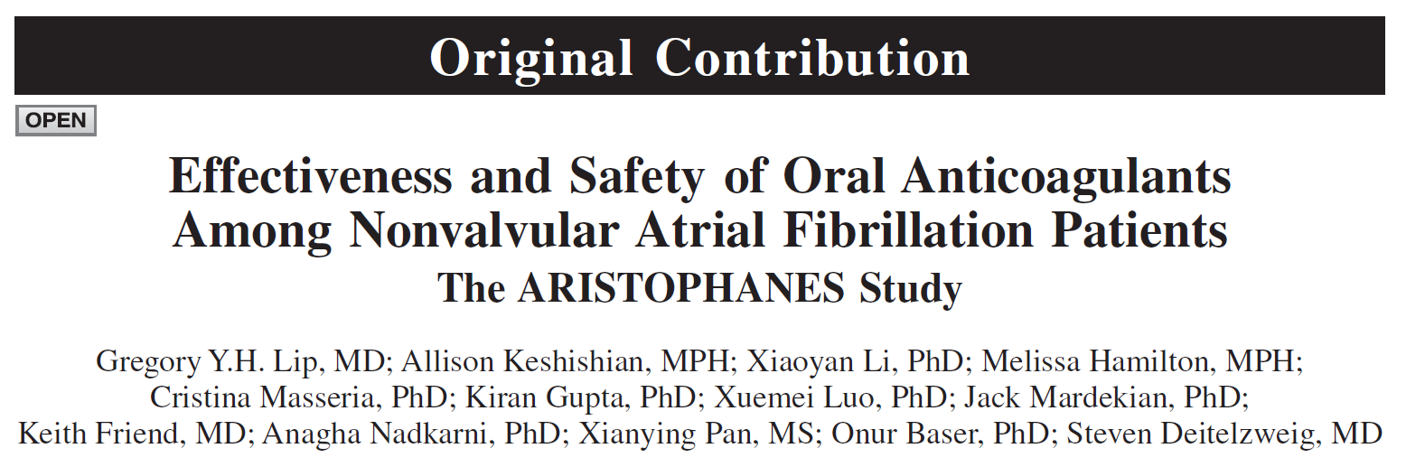
Stroke. 2018;49
DOI: 10.1161/STROKEAHA.118.020232.
The largest observational study on oral anticoagulants to date with 285,292 patients
Notes:
Speaker Notes:

Slide 28
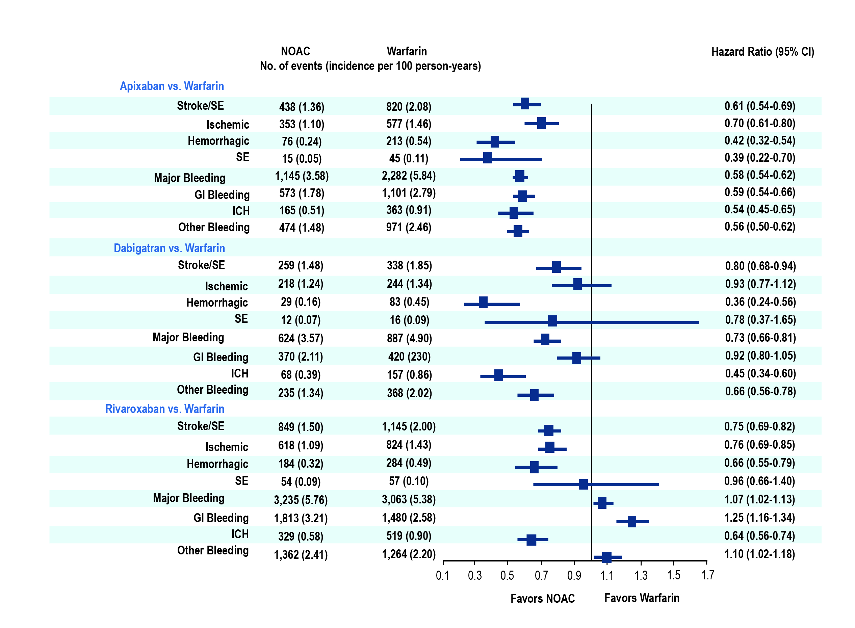
Main Analysis:
DOACs vs VKA
Stroke. 2018;49 DOI: 10.1161/STROKEAHA.118.020232
Notes:
Speaker Notes:

Slide 29
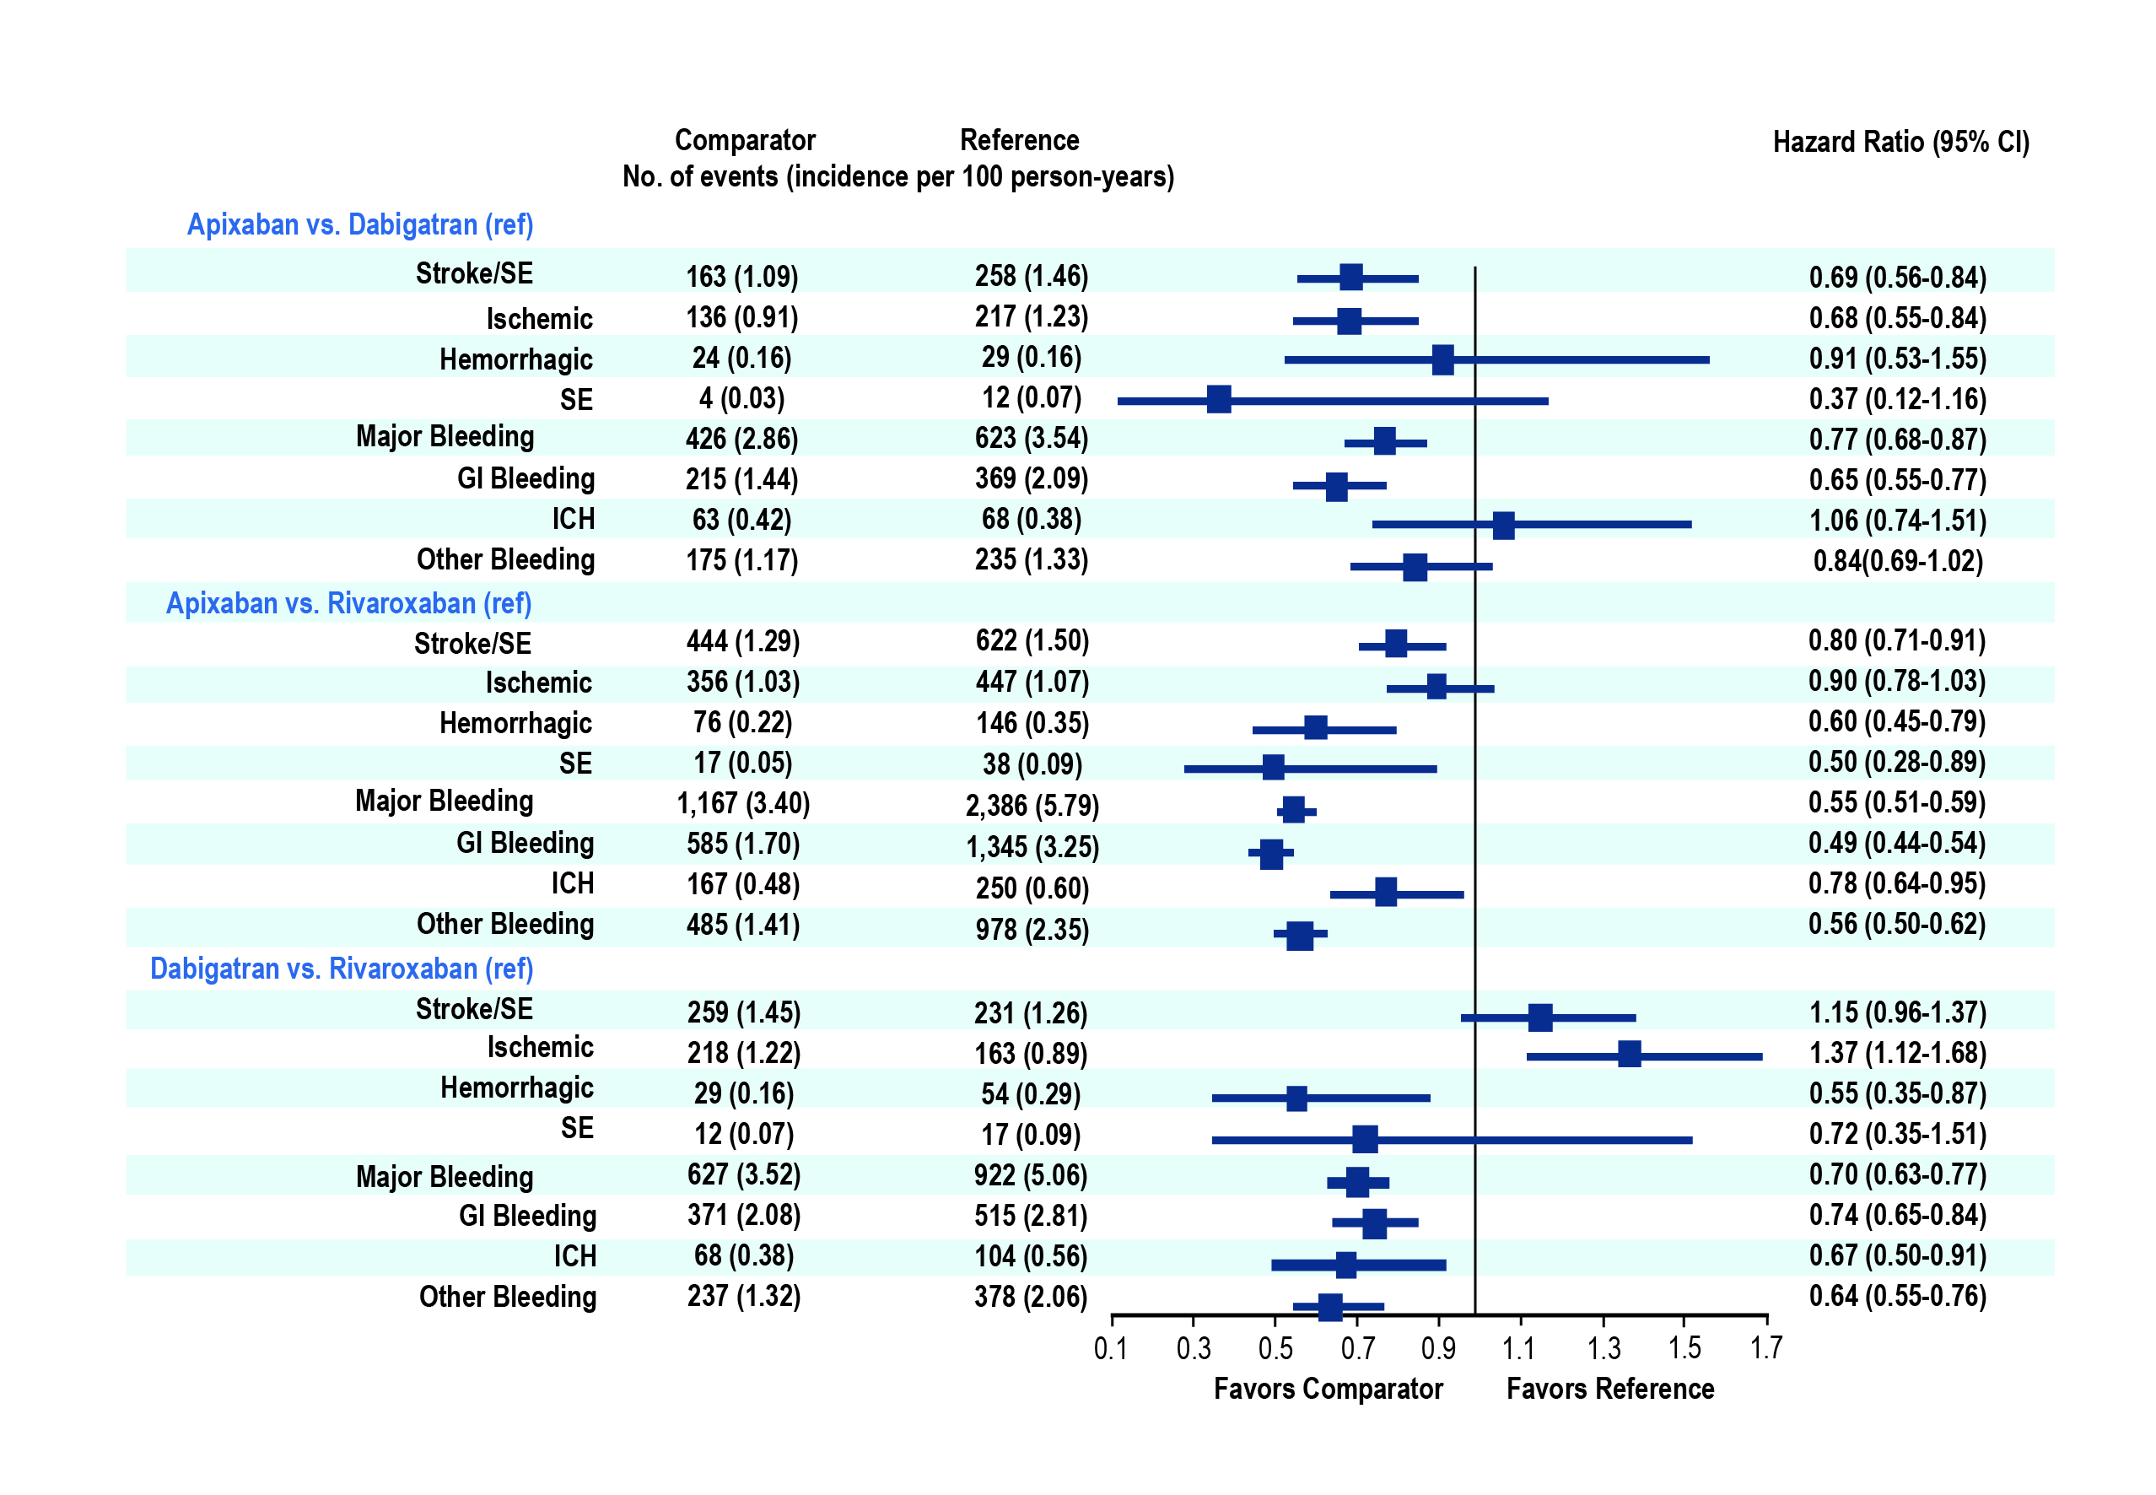
Main Analysis:
DOAC vs DOAC
Stroke. 2018;49 DOI: 10.1161/STROKEAHA.118.020232
Notes:
Speaker Notes:

Slide 30
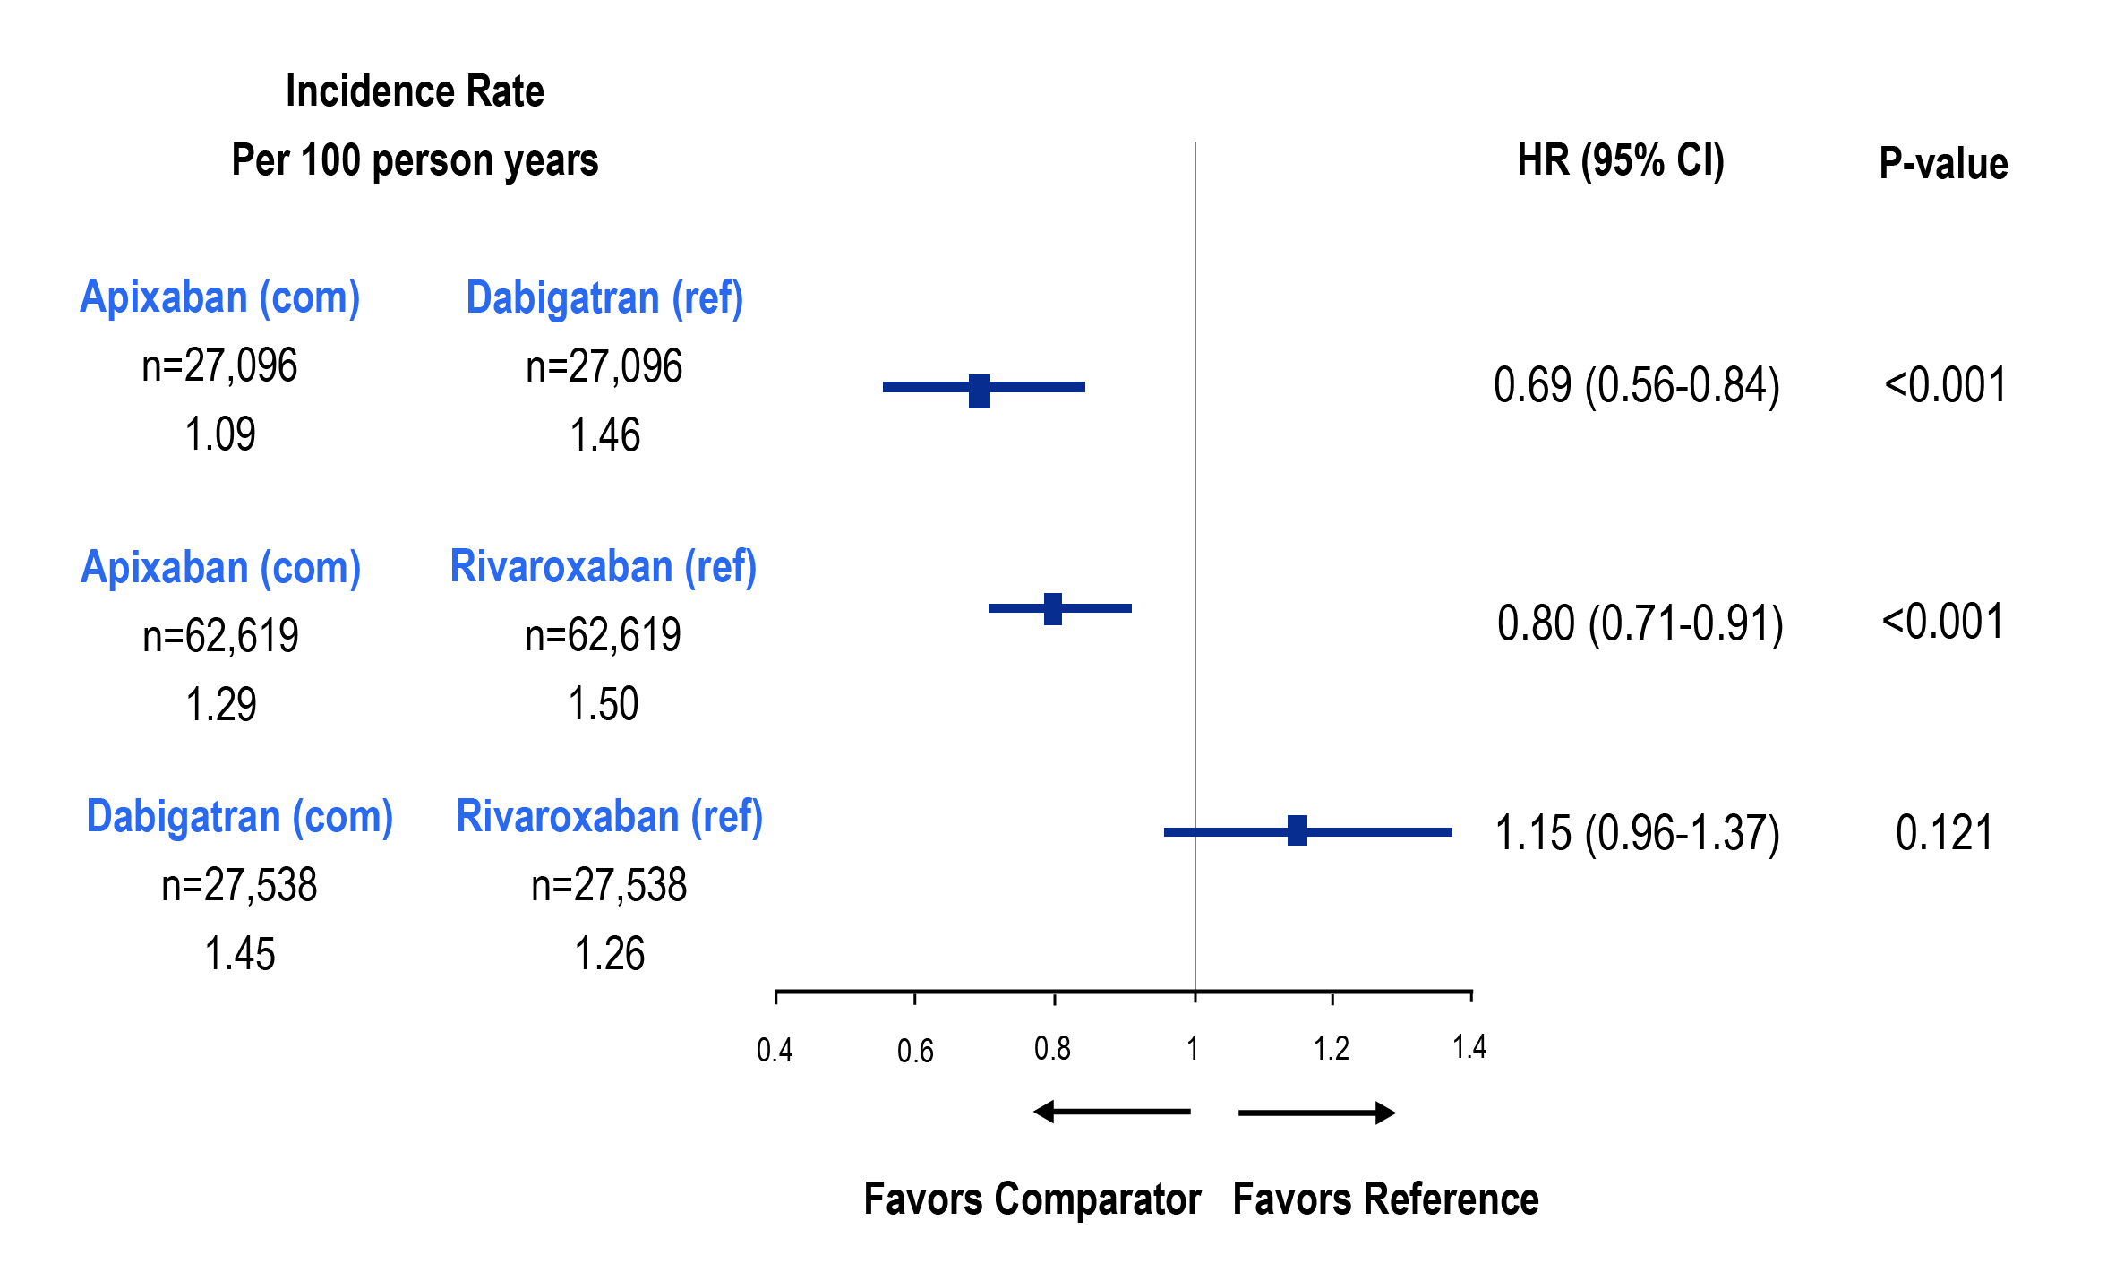
Propensity Score Matching-Adjusted Hazard Ratio of Stroke/Systemic Embolism
Each comparator cohort was independently propensity score matched against reference cohort. Therefore, comparisons cannot be made among the three separate matched cohorts of the analysis.
CI, confidence interval; com, comparator; HR, hazard ratio; PSM, propensity score matching; ref, reference; SE, systemic embolism.
Deitelzweig S et al. Poster presentation at ESC 2018, 25-29 August, Munich, Germany, poster P2567.
Notes:
Speaker Notes:

Slide 31
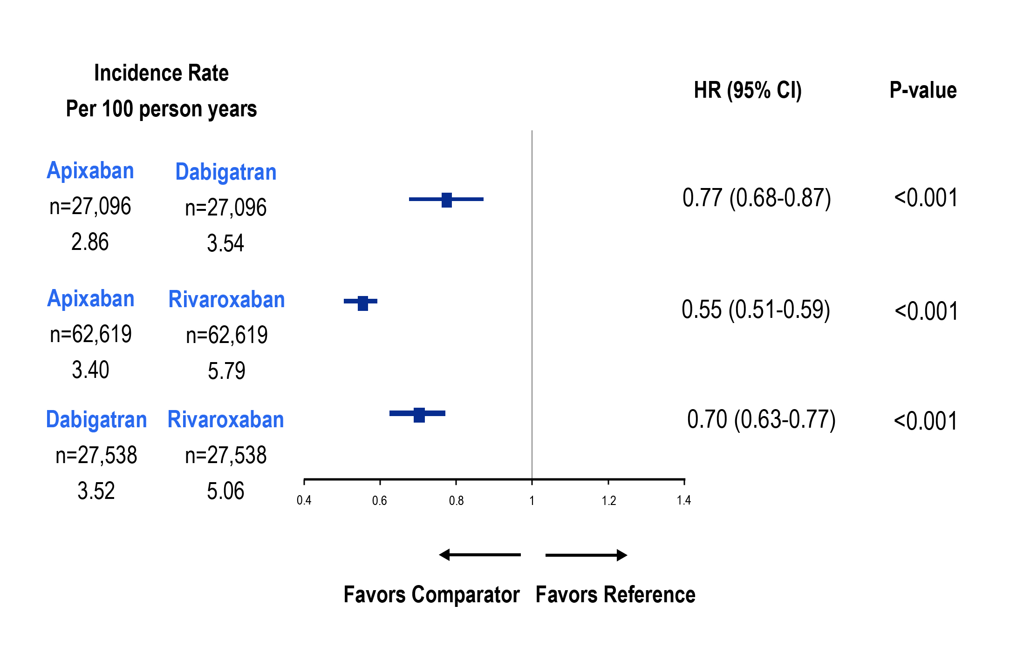
Propensity Score Matching-Adjusted Hazard Ratio of Major Bleeding
Each comparator cohort was independently propensity score matched against reference cohort. Therefore, comparisons cannot be made among the three separate matched cohorts of the analysis
CI, confidence interval; com, comparator; HR, hazard ratio; MB, major bleeding; ref, reference; SE, systemic embolism.
Deitelzweig S et al. Poster presentation at ESC 2018, 25-29 August, Munich, Germany, poster P2567.
Notes:
Speaker Notes:

Slide 32
Effectiveness and Safety of Dabigatran, Rivaroxaban, and Apixaban Versus Warfarin in Nonvalvular Atrial Fibrillation
Yao X, Abraham NS, Sangaralingham LR, Bellolio MF, McBane RD, Shah ND, Noseworthy PA
Yao et al. J Am Heart Assoc. 2016;5:e003725
Notes:
Speaker Notes:
Cohort Creation
Apixaban, dabigatran, rivaroxaban or warfarin users (10/1/2010-6/30/2015) N=1,873,941
12-month continuous enrollment N= 289,246 warfarin and N=83,084 DOAC
Patients with AF at baseline N=176,723
Exclude: valvular heart disease, ESRD/dialysis N=126,178
Final sample:
Dabigatran vs Warfarin (N=28,614)
Rivaroxaban vs Warfarin (N=32,350)
Apixaban vs Warfarin (N=15,390)
Propensity matching on 38 clinical variables

Slide 33
Apixaban vs. Warfarin
 |  | ARISTOLE Apixaban vs. Warfarin
 |  | HR (95% CI)
Stroke or systemic embolism |  | 0.79* (0.66, 0.95)
Major Bleeding |  | 0.69*** (0.60, 0.80)
Intracranial |  | 0.42*** (0.30, 0.58)
OLDW
Apixaban vs. Warfarin
HR (95% CI)
0.67* (0.46, 0.98)
0.45*** (0.34, 0.59)
0.24*** (0.12, 0.50)
*p<0.05, **p<0.01, ***p<0.001
Yao, Noseworthy JAHA 2016
Notes:
Speaker Notes:

Slide 34
Dabigatran vs. Warfarin
 |  | RE-LY Dabigatran vs. Warfarin
 |  | HR (95% CI)
Stroke or systemic embolism |  | 0.66*** (0.53, 0.82)
Major bleeding |  | 0.93 (0.81, 1.07)
Intracranial |  | 0.40*** (0.27, 0.60)
OLDW
Dabigatran vs. Warfarin
HR (95% CI)
0.98 (0.76, 1.26)
0.79** (0.64, 0.94)
0.36*** (0.23, 0.56)
*p<0.05, **p<0.01, ***p<0.001
†RE-LY results are from 150 mg; RE-LY used intent-to-treat analysis for safety outcomes
Yao, Noseworthy JAHA 2016
Notes:
Speaker Notes:

Slide 35
Rivaroxaban vs. Warfarin
 |  | ROCKET-AF Rivaroxaban vs. Warfarin
 |  | HR (95% CI)
Stroke or systemic embolism |  | 0.88 (0.75, 1.03)
Major Bleeding |  | 1.04 (0.90, 1.20)
Intracranial |  | 0.67* (0.47, 0.93)
OLDW
Rivaroxaban vs. Warfarin
HR (95% CI)
0.93 (0.72, 1.19)
1.04 (0.90, 1.20)
0.51*** (0.35, 0.75)
*p<0.05, **p<0.01, ***p<0.001
Yao, Noseworthy JAHA 2016
Notes:
Speaker Notes:

Slide 36
What are the other implications of a Once-Daily versus Twice-Daily DOAC?
Notes:
Speaker Notes:

Slide 37

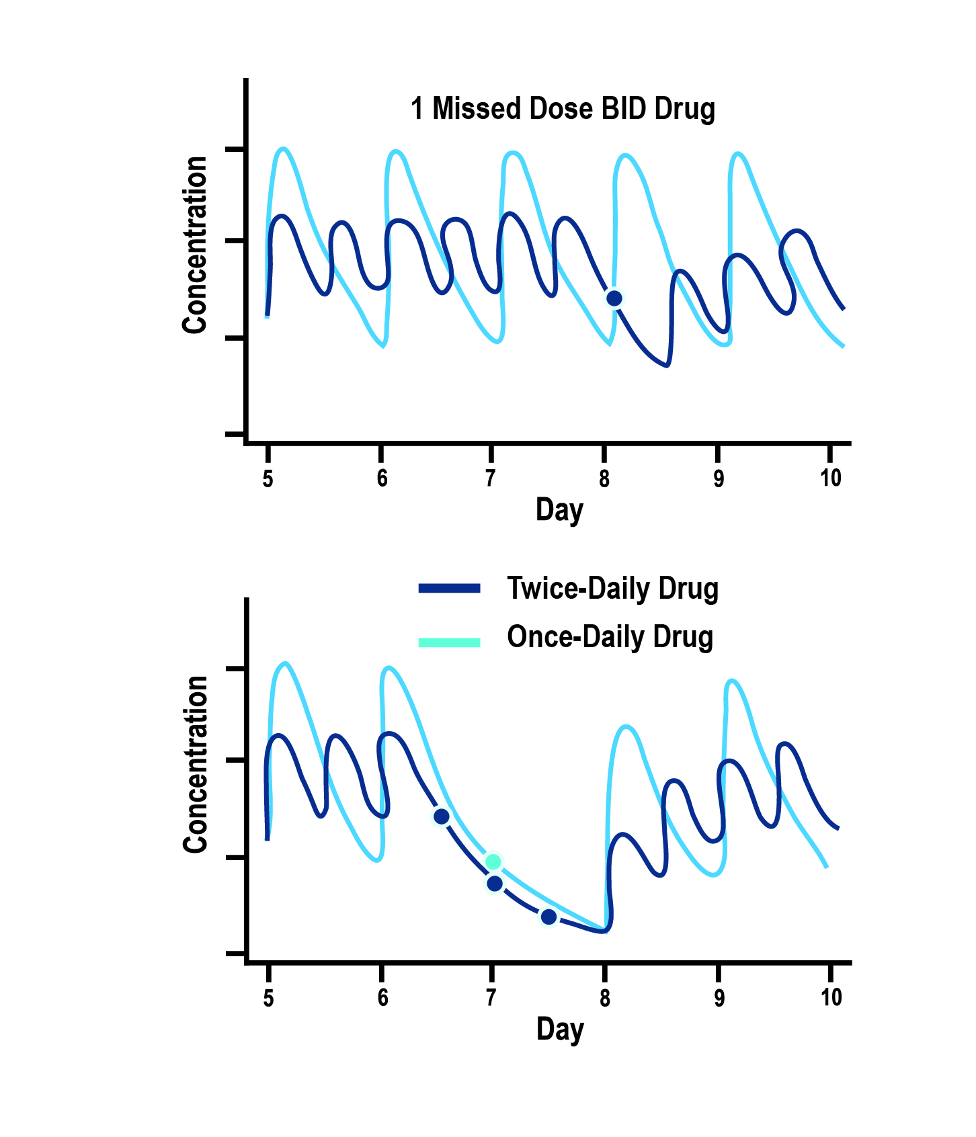
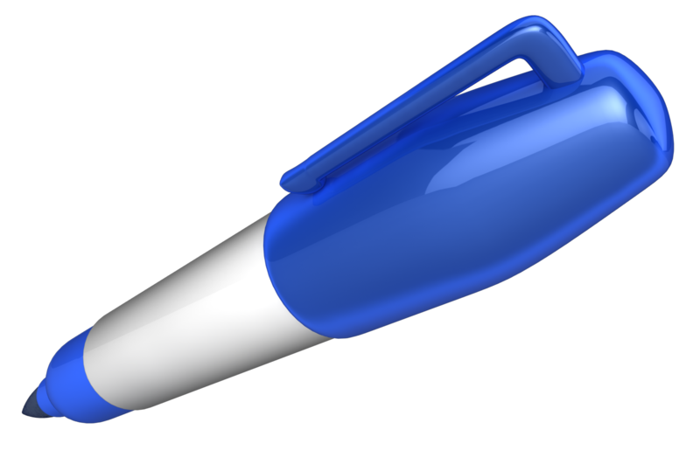
Dosing Considerations and Implications of a Single Missed Dose
Dosing also has implications on the impact of a single missed dose.
One missed dose of QD drug ≠ One missed dose of BID drug
1 missed QD dose equals 3 missed BID doses
Comparative effects of prescribing the same total daily dose, given either once-daily (QD) or as half-strength twice-daily (BID) doses, for the same drug, or 2 drugs with identical pharmacokinetic parameters:
Twice-daily dosing regimen is less prone to high peaks or low troughs in anticoagulant concentrations and associated actions.
Disproportionately greater impact on drug action of skipping a once-daily than a twice-daily dose
Vrijens B, Heidbuchel H. Europace. 2015 Apr;17(4):514-23.
Notes:
Speaker Notes:
From a pharmacodynamics standpoint for DOACs with a short 12 hour half-life, missing a dose of a once-daily drug exposes to patient to a period of relative under-anticoagulation and risk of stroke/SE. By the time the next dose is taken, 48 hours (or four half-lives) have potentially elapsed and only 12.5% of the DOAC remains in the system.
A patient would have to miss three consecutive doses of a DOAC taken twice-daily for an equivalent risk exposure. Being on a once-daily DOAC may therefore not be an advantage for a forgetful patient who frequently misses doses as he/she is less likely to miss three consecutive doses of medication.

Slide 38
What does persistence with DOACs look like?
Notes:
Speaker Notes:

Slide 39
Discontinuation Rates from Randomized Clinical Registration Trials
Frequency treatment discontinuation in phase 3 trials.
Odds ratios and 95% confidence intervals (CIs) were calculated from the reported event frequencies
Studies Estimate (95% CI)
RELY 150 mg BID 1.358 (1.234, 1.494)
RELY 110 mg BID 1.413 (1.285, 1.553)
ROCKET-AF 20 mg OD 1.088 (1.006, 1.177)
ARISTOTLE 5 mg BID 0.893 (0.836, 0.954)
ENGAGE-AF 60 mg OD 0.999 (0.932, 1.071)
ENGAGE-AF 30 mg OD 0.935 (0.872, 1.003)
1.094 (0.949, 1.261)
Komocsi A. Curr Med Res Opin. 2015; 31(10):1841-4.
Notes:
Speaker Notes:
Methods: The authors analyzed treatment discontinuation frequencies in phase 3 trials of anticoagulant treatment in non-valvular atrial fibrillation in a frequentist random effect metaanalysis and in Bayesian multiple treatment network comparison.
Results: Frequency of discontinuations are heterogeneous and highly inconsistent Discontinuations were the most frequent with dabigatran followed by rivaroxaban, warfarin, edoxaban and apixaban.
Rivaroxaban were less frequently discontinued when compared to the two doses of dabigatran. (OR 0.80; 95% CI: 0.71–0.91 versus 150 mg b.i.d., and OR: 0.77; 95% CI: 0.68–0.87 versus 110 mg b.i.d.).
Conclusion:
Important differences exist among the treatment adherence of different anticoagulant protocols. Discontinuation rates experienced during the clinical trials may predict the real life patient persistence

Slide 40
Mayo Clinic Real World Data Analysis
of Non-Adherence
Mean age 73 yrs (IQR 64-80 yrs); 56% male
89.6% had CHA₂DS₂-VASc ≥2, 47.8% had HAS-BLED ≥3
Compliance defined as ≥80% of days covered by OAC
Adjusted for potential confounders
52.1
47.6
45.9
Compliance (%)
38.7
Apixaban
Rivaroxaban
Dabigatran
Warfarin
Yao X et al. J Amer Coll Cardiol 69:2779-90, 2017
Notes:
Speaker Notes:

Slide 41

Key Messages
AF is a common and important cause of stroke and needs to be rigorously ruled out in idiopathic stroke
Appropriate anticoagulation treatment should be started when indicated in the vast majority of AF patients as per the 2018 CCS guidelines
DOACs offer several advantages over warfarin, and should generally be used in preference to warfarin for SPAF as per 2018 CCS guidelines
Risk of bleeding should be modified where possible but very rarely outweighs the risk of stroke
Patient characteristics and co-morbidities (age, renal function, etc) should be considered when selecting and dosing DOACs
Real world evidence provides reassurance of the efficacy and safety of DOACs in SPAF but highlights the challenges of correct dosing and compliance
Notes:
Speaker Notes:
Most patients with AF and CAD who are eligible for OAC according to CHADS-65 end up on a DOAC alone after 12 months of CAD “stability”, defined as no ACS or need for revascularization (PCI or CABG).

Slide 42


Addressing Common Clinical Conundrums in AF

Slide 43

1
Do DOACs work and are they safe in the elderly and frail?
How do I manage DOACs in the setting of advanced chronic renal failure (CRF) with eGFR < 30 ml/min/173m²?
2
3
Do DOACs retain efficacy at stroke prevention in patients weighing over 120 Kg?
4
Should I reduce the DOAC dosage in the setting of liver failure?
5
Should DOACs be held before implantation of a pacemaker or defibrillator?
6
How should I manage a severe or life-threatening bleed in patients on a DOAC?

Slide 44
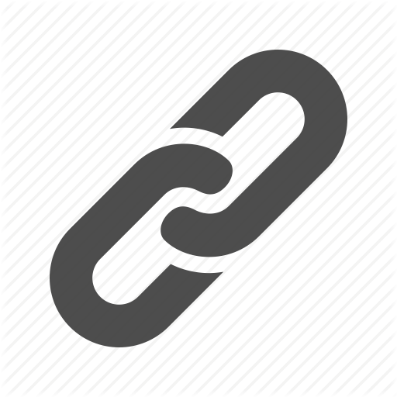
1
Do DOACs work and are they safe in the elderly and frail?
How do I manage DOACs in the setting of advanced chronic renal failure (CRF) with eGFR < 30 ml/min/173m²?
2
3
Do DOACs retain efficacy at stroke prevention in patients weighing over 120 Kg?
4
Should I reduce the DOAC dosage in the setting of liver failure?
5
Should DOACs be held before implantation of a pacemaker or defibrillator?
6
How should I manage a severe or life-threatening bleed in patients on a DOAC?

Slide 45
DOACs in Patients Aged ≥ 75 years with Atrial Fibrillation: Impact on Stroke and Bleeding Risk
Control groups: Warfarin ASA
Stroke Risk | n ≥75 yrs | Hazard ratios (95% CI)
RE-LY Dabigatran 110 mg bid Dabigatran 150 mg bid | 7,258 |  | 0.88 (0.66-1.17) 0.67 (0.49-0.90)
ROCKET AF Rivaroxaban 20 mg qd | 6,229 |  | 0.88 (0.75-1.03)
ARISTOTLE Apixaban 5 mg bid | 5,678 |  | 0.79 (0.65-0.95)
AVERROES Apixaban 5 mg bid* | 1,897 |  | 0.46 (0.33-0.65)
Risk of Major Bleeding | n ≥75 yrs | Hazard ratios (95% CI)
RE-LY Dabigatran 110 mg bid Dabigatran 150 mg bid | 7,258 |  | 1.01 (0.83-1.23) 1.18 (0.98-1.42)
ROCKET AF Rivaroxaban 20 mg qd | 6,229 |  | 1.04 (0.90-1.20)
ARISTOTLE Apixaban 5 mg bid | 5,678 |  | 0.69 (0.60-0.80)
AVERROES Apixaban 5 mg bid* | 1,897 |  | 1.13 (0.74-1.75)
Ruff, Lancet, 2014, 383, 955
0.5
1.0
1.5
Favours DOAC
Favours Control
*vs. aspirin
Cited in Ng KH, et al. Cardiol Ther 2013 Dec; 2(2):135-49.
Notes:
Speaker Notes:
The major pivotal trials for the first three novel anticoagulants compared against warfarin (RE-LY, ROCKET-AF and ARISTOTLE) included substantial numbers of patients aged 75 years or older..
RE-LY: n=7,258
ROCKET-AF: n=6,229
ARISTOTLE: n=5,678
Also included on this slide is AVERROES, which compared apixaban to aspirin and also included a large number of patients aged 75 years or older. (n=1,897). As shown in the Forest plot, dabigatran 150 mg bid and apixaban 5 mg bid were associated with significant reductions in stroke risk relative to warfarin, while apixaban 5 mg bid was associated with a significant reduction in risk of major hemorrhage.
Note that in ROCKET-AF, the dose of rivaroxaban was reduced to 15 mg once daily if estimated creatinine clearance was 30-49 mL/min. In AVERROES, the apixaban dose was 2.5 mg bid if 2 out of 3 of these criteria were met: serum creatinine ≥ 133 ml/min, age ≥ 80 years or weight ≤ 60 kg.
References:
1. Connolly SJ, Ezekowitz MD, Yusuf S, et al. Dabigatran versus warfarin in patients with AF. N Engl J Med 2009; 361:1139-51.
2. Patel MR, Mahaffey KW, Garg J, et al. Rivaroxaban versus warfarin in nonvalvular AF. N Engl J Med 2011; 365:883-91.
3. Granger CB, Alexander JH, McMurray JJ, Lopes RD, Hylek EM, Hanna M, et al. Apixaban versus warfarin in patients with AF. N Engl J Med. 2011;365:981–992.
4. Connolly SJ, Eikelboom J, Joyner C, Diener H-C, Hart R, Golitsyn S, et al. Apixaban in patients with AF. N Engl J Med. 2011; 364:806-17.
Cited in: Ng KH, Hart RG, Eikelboom JW. Anticoagulation in Patients Aged ≥75 years with Atrial Fibrillation: Role of Novel Oral Anticoagulants. Cardiol Ther 2013; 2(2):135-49.

Slide 46
AVERROES: Above and below 75 years of age
Stroke Prevention
Age <75 years
HR with apixaban, 0.68
(95% Cl, 0.42–1.08)
Age ≥75 years
HR with apixaban, 0.33
(95% Cl, 0.19–0.54)
0.08
0.08
0.07
0.07
0.06
0.06
ASA
0.05
0.05
0.04
0.04
Cumulative hazard
Cumulative hazard
0.03
ASA
0.03
0.02
0.02
Apixaban
0.01
Apixaban
0.01
0.00
0.00
0
3
6
9
12
15
18
0
3
6
9
12
15
18
Months
Months
No. at risk
No. at risk
ASA
1799
1766
1643
1384
1009
675
402
ASA
992
951
885
730
536
375
229
Apixaban
1901
1869
1745
1455
1037
722
419
Apixaban
906
887
820
651
479
327
196
Cumulative hazard rates of stroke in ASA and apixaban
treatment groups, in patients <75 years or ≥ 75 years old.
P-value for interaction = 0.04
Age and Ageing 2015: 0:1-7 doi: 10.1093/ageing/afv156
Notes:
Speaker Notes:
Increased efficacy of apixaban in the elderly
In this paper we have reported evidence that for stroke prevention,
the efﬁcacy of apixaban in comparison to aspirin
increases with age. In patients =75 years, there was a greater
relative risk reduction with apixaban (HR 0.33, 95% CI
0.18–0.56) compared with younger patients (HR 0.68, 95%
CI 0.42–1.08; P-value for interaction = 0.04) (Figure 1). The
number needed to treat (NNT, calculated as 1/[absolute risk
reduction]) per year to prevent a stroke was 26 in patients
=75 compared with a NNT of 143 in younger patients. In
contrast, the relative efﬁcacy of aspirin to prevent ischaemic
stroke decreases as patients with AF age and appears ineffectual
as patients enter their eighth decade [8]. The beneﬁtof
apixaban with advancing age appears to be due to a rapidly
increasing stroke risk on aspirin, whereas the stroke risk on
apixaban is relatively consistent across age groups (Figure 2A).
In the absence of a comparator group with no antiplatelets or
anticoagulants, it is not possible to determine conclusively
from our data if this is due to a loss of efﬁcacy of aspirin with
age or an increase in efﬁcacy with apixaban. However, as most
elderly patients not anticoagulated will be prescribed aspirin,
the ﬁndings of this analysis are clinically relevant.

Slide 47
AVERROES: Above and below 75 years of age
Bleeding
Age <75 years
HR with apixaban, 1.14
(95% Cl, 0.58–2.30)
Age ≥75 years
HR with apixaban, 1.21
(95% Cl, 0.69–2.12)
0.08
0.08
0.07
0.07
0.06
0.06
0.05
0.05
0.04
0.04
Cumulative hazard
Cumulative hazard
Apixaban
0.03
0.03
0.02
Apixaban
0.02
ASA
0.01
0.01
0.00
ASA
0.00
0
3
6
9
12
15
18
0
3
6
9
12
15
18
Months
Months
No. at risk
No. at risk
ASA
1799
1776
1654
1397
1019
682
407
ASA
992
960
896
740
548
382
233
Apixaban
1901
1872
1748
1455
1040
724
424
Apixaban
906
885
816
645
474
321
195
Cumulative hazard rates of major bleeding in ASA and apixaban
treatment groups, in patients <75 years or ≥ 75 years old.
P-value not available
Age and Ageing 2015: 0:1-7 doi: 10.1093/ageing/afv156
Notes:
Speaker Notes:
Risk of bleeding with initiation of apixaban
Patients enrolled onto AVERROES were not anticoagulated
with vitamin K antagonist therapy either because it was unsuitable
or expected to be unsuitable. Multiple physician and
patient factors were listed for patients not being suitable for
VKA but most patients were unsuitable for multiple reasons
(Supplementary data, Table S4, available in Age and Ageing
online). A large proportion of older patients (42.6%) had
previously failed VKA therapy and of that group, 9.5% had
serious bleeding due to VKA therapy.
In general, apixaban has a similar major bleeding rate to
aspirin in patients who were previously not deemed suitable
for anticoagulation with VKA. The risk of bleeding increased
on both treatments with age (Figure 2B). However even in
the very elderly, apixaban was as safe as aspirin in regards to
bleeding. For intracranial haemorrhage, there is some evidence
that apixaban is safer than aspirin in patients =85
years though absolute event rates were low.

Slide 48
1
Do DOACs work and are they safe in the elderly and frail?
How do I manage DOACs in the setting of advanced chronic renal failure (CRF) with eGFR < 30 ml/min/173m²?
2
3
Do DOACs retain efficacy at stroke prevention in patients weighing over 120 Kg?
4
Should I reduce the DOAC dosage in the setting of liver failure?
5
Should DOACs be held before implantation of a pacemaker or defibrillator?
6
How should I manage a severe or life-threatening bleed in patients on a DOAC?

Slide 49
DOAC Dosing Recommendations for Stroke Prevention in AF in Patients with Renal Impairment According to the Canadian Product Monographs
Pfizer Canada Inc./BMS Canada. Eliquis (apixaban) Product Monograph, 2018.
Boehringer Ingelheim Canada Ltd. Pradaxa (dagbatran) Product Monograph. August 11, 2016.
Bayer Inc. Xarelto (rivaroxaban) Product Monograph. 2018.
Daiichi Sankyp Inc. Lixiana (edoxaban) Product Monograph. 2017.
Notes:
Speaker Notes:
*ABC criteria: Dose reduction to 2.5 mg BID if at least 2 of the following: Age ≥ 80, Body weight ≤ 60kg, serum Creatinine ≥ 133 micromol/L (1.5 mg/dL)
**Moderate renal impairment: Use with caution especially in those concomitantly receiving other drugs which increase rivaroxaban plasma concentrations, consider the benefit/risk of anticoagulant therapy before administering rivaroxaban to patients with moderate renal impairment having a creatinine clearance close to the severe renal impairment category (CrCl < 30 mL/min), or in those with a potential to have deterioration of renal function to severe impairment during therapy.
DOAC, non-vitamin K antagonist oral anticoagulant; AF, atrial fibrillation; CrCL, estimated creatinine clearance

Slide 50
Considerations for Dosing of DOACs
Pfizer Canada Inc./BMS Canada. Eliquis (apixaban) Product Monograph, 2018.
Boehringer Ingelheim Canada Ltd. Pradaxa (dagbatran) Product Monograph. August 11, 2016.
Bayer Inc. Xarelto (rivaroxaban) Product Monograph. 2018.
Daiichi Sankyp Inc. Lixiana (edoxaban) Product Monograph. 2017.
Notes:
Speaker Notes:
Indispensable slide summarizing the criteria for a dosage adjustment from the default higher dosage for the different DOACs currently available in Canada
The dosing adjustments proposed for apixaban, edoxaban and rivaroxaban are those utilized to the dosage of selected patients enrolled in the respective prospective clinical trials (ARISTOTLE, ENGAGE and ROCKET-AF). The overall goal was to achieve a stable plasma concentration in subjects assigned to DOAC therapy in these studies.
The speaker should emphasize that the RELY study, in fact, tested two separate dosages of dabigatran (150 mg and 110 mg BID) independently against warfarin, without a pre-specified dosage reduction algorithm for reduced renal function. Since dabigatran is known to be 85% renally cleared, the Canadian AF Guidelines Committee subsequently proposed dosing adjustments (as did all other guideline committees), as listed in the table, for elderly patients and those with stage 3 renal dysfunction in order to minimize the risk of drug accumulation and bleeding in these patients.

Slide 51
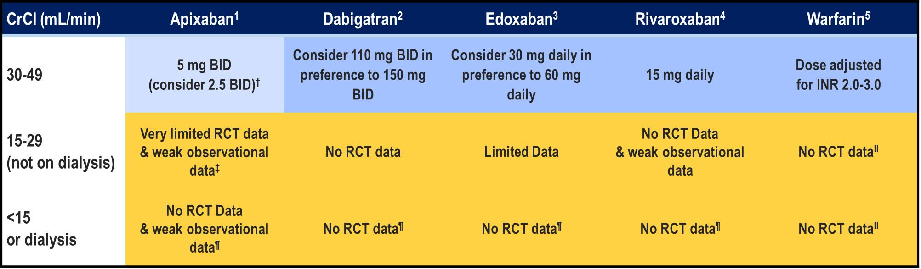
Limited evidence for DOACs in AF patients with Advanced (stages 4-5) CRF
Pfizer Canada Inc./BMS Canada. Eliquis (apixaban) Product Monograph, 2018.
Boehringer Ingelheim Canada Ltd. Pradaxa (dagbatran) Product Monograph. August 11, 2016.
Bayer Inc. Xarelto (rivaroxaban) Product Monograph. 2018.
Daiichi Sankyp Inc. Lixiana (edoxaban) Product Monograph. 2017.
Notes:
Speaker Notes:
The DOACs are at least partially eliminated by the kidneys. Dabigatran and edoxaban have the greatest dependence on renal elimination (~85% and 50%, respectively),^{8, 9} whereas 27% and 33% of apixaban and rivaroxaban, respectively, are renally cleared as unchanged drug.

Slide 52
1
Do DOACs work and are they safe in the elderly and frail?
How do I manage DOACs in the setting of advanced chronic renal failure (CRF) with eGFR < 30 ml/min/173m²?
2
3
Do DOACs retain efficacy at stroke prevention in patients weighing over 120 Kg?
4
Should I reduce the DOAC dosage in the setting of liver failure?
5
Should DOACs be held before implantation of a pacemaker or defibrillator?
6
How should I manage a severe or life-threatening bleed in patients on a DOAC?

Slide 53
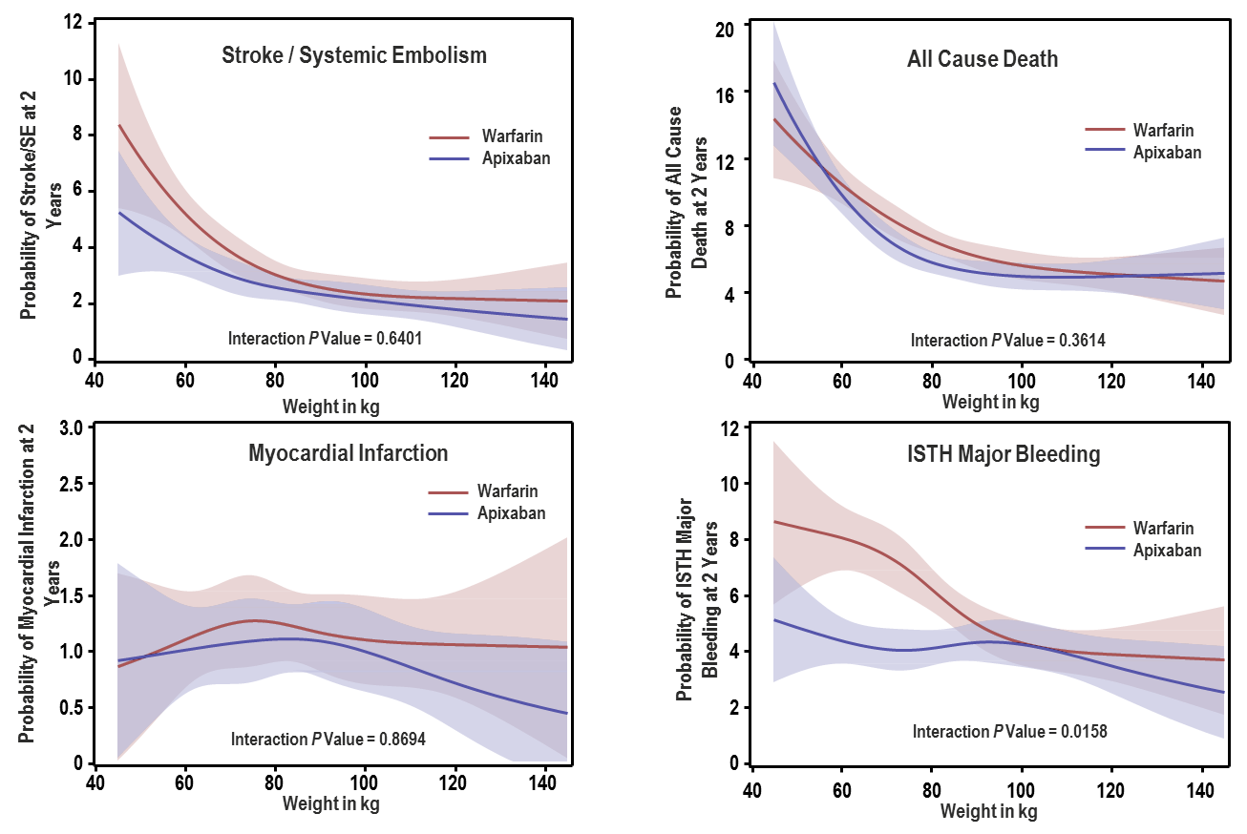
Results: Efficacy and Safety Outcomes for Apixaban vs Warfarin Use With Weight as a Continuous Variable
ISTH, International Society on Thrombosis and Haemostasis; SE, systemic embolism.
Fudim M et al. Poster presentation at ACC 2018, 10–12 March, Orlando, FL, USA, poster 1225M-09
Notes:
Speaker Notes:
Of the 18,139 patients enrolled in ARISTOTLE who had weight and outcomes data recorded, 1985 (10.9%) patients were in the low weight group (≤60 kg), 15,172 (83.6%) were in the mid-range weight group (>60 to 120 kg), and 982 (5.4%) were in the high weight group (>120 kg).
Overall, the efficacy and safety of apixaban versus warfarin appear to be similar in patients with very high or very low body weight when compared with those without extremes of body weight.
Apixaban retained its stroke/SE efficacy advantage over warfarin at the extremes ((≤60 kg and >120 kg) of body weight (top left of the slide).
Occurrence of myocardial infarction was similar to warfarin at low body weight but lower with apixaban at high body weight (bottom left of the slide)
All cause mortality was similar between apixaban and warfarin at any body weight ((to right of the slide)
Major bleeding was lower with apixaban vs. warfarin at all body weights but particularly in patients with lower body weight (lower right of the slide)

Slide 54
Is There an Obesity Paradox for Outcomes in Atrial Fibrillation?
There may be an obesity paradox in atrial fibrillation patients, particularly for all-cause and cardiovascular death outcomes. An obesity paradox was also evident for stroke/systemic embolic event outcome in DOAC trials, with a treatment effect favoring DOACs over warfarin for both efficacy and safety that was significant only for normal weight patients.
A Systematic Review and Meta-Analysis of Non–Vitamin K Antagonist Oral Anticoagulant Trials
Obesity is a risk factor for all-cause and cardiovascular death but, despite this, an inverse relationship between overweight or obesity and a better cardiovascular prognosis in long-term follow-up studies has been observed; this phenomenon, described as obesity paradox, has also been found evident in atrial fibrillation cohorts.
An obesity paradox was found for cardiovascular death and all-cause death in the subgroup analyses of randomized trial cohorts; however, observational studies fail to show this relationship. From the meta-analysis of DOAC trials, a significant obesity paradox was found, with both overweight and obese patients reporting a lower risk for stroke/systemic embolic event (odds ratio [OR], 0.75; 95% confidence interval [CI], 0.66–0.84 and OR, 0.62; 95% CI, 0.54–0.70, respectively).
For major bleeding, only obese patients were at lower risk compared with normal weight patients (OR, 0.84; 95% CI, 0.72–0.98).
A significant treatment effect of DOACs was found in normal weight patients, both for stroke/systemic embolic event (OR, 0.66; 95% CI, 0.56–0.78) and for major bleeding (OR, 0.72; 95% CI, 0.54–0.95). Major bleeding risk was lower in overweight patients treated with DOACs (OR, 0.84; 95% CI, 0.71–1.00).
Proietti M., et al; Volume: 48, Issue: 4, Pages: 857-866, 2017 DOI: (10.1161/STROKEAHA.116.015984)
Notes:
Speaker Notes:
Abstract
Background and Purpose—
Obesity is a risk factor for all-cause and cardiovascular death but, despite this, an inverse relationship between overweight or obesity and a better cardiovascular prognosis in long-term follow-up studies has been observed; this phenomenon, described as obesity paradox, has also been found evident in atrial fibrillation cohorts.
Methods—
We performed a systematic review on the relationship between body mass index and major adverse outcomes in atrial fibrillation patients. Moreover, we provided a meta-analysis of non–vitamin K antagonist oral anticoagulants (DOACs) trials.
Results—
An obesity paradox was found for cardiovascular death and all-cause death in the subgroup analyses of randomized trial cohorts; however, observational studies fail to show this relationship. From the meta-analysis of DOAC trials, a significant obesity paradox was found, with both overweight and obese patients reporting a lower risk for stroke/systemic embolic event (odds ratio [OR], 0.75; 95% confidence interval [CI], 0.66–0.84 and OR, 0.62; 95% CI, 0.54–0.70, respectively). For major bleeding, only obese patients were at lower risk compared with normal weight patients (OR, 0.84; 95% CI, 0.72–0.98). A significant treatment effect of DOACs was found in normal weight patients, both for stroke/systemic embolic event (OR, 0.66; 95% CI, 0.56–0.78) and for major bleeding (OR, 0.72; 95% CI, 0.54–0.95). Major bleeding risk was lower in overweight patients treated with DOACs (OR, 0.84; 95% CI, 0.71–1.00).
Conclusions—
There may be an obesity paradox in atrial fibrillation patients, particularly for all-cause and cardiovascular death outcomes. An obesity paradox was also evident for stroke/systemic embolic event outcome in DOAC trials, with a treatment effect favoring DOACs over warfarin for both efficacy and safety that was significant only for normal weight patients.
Discussion
Our systematic review of the literature seems suggestive of an obesity paradox in AF patients, in particular for all-cause and cardiovascular death outcomes, notwithstanding the presence of associated comorbidities or more intensive pharmacological treatments. This evidence seems to rise particularly from data from subgroup analyses of RCTs; conversely, observational studies with unadjusted analyses show the same evidence, but after statistical adjustments, the advantage of overweight and obese patients is less evident in most of the studies. Finally, an obesity paradox was evident for stroke/SEE outcome and major bleeding in the randomized trials of DOACs for stroke prevention in AF, with a treatment effect favoring DOACs compared with warfarin that was significant for normal weight patients.
Publications on the obesity paradox have progressively increased in recent years, particularly among patient with cardiovascular disease.⁴ A better prognosis, both in terms of all-cause and cardiovascular death, for overweight and obese patients has been reported for patients diagnosed with hypertension, coronary artery disease, congestive heart failure, and peripheral arterial disease.⁶ Indeed, our systematic review shows several studies in AF patients in which an obesity paradox was evident. This phenomenon was most evident in RCT-derived cohorts, whereas in observational studies, the differences in adverse outcomes were no longer apparent after statistical adjustments for associated comorbidities in obese patients, leading to more intense risk factor management and hence improved outcomes.^{11,22}Trial data show that the impact of BMI categories was attenuated by good anticoagulation control, again suggesting that optimized treatments could mitigate the obesity paradox.^{12,14} Such evidence altogether reaffirms the necessity for a more holistic approach to AF management, which would include treating overweight and obese AF patients.²⁶
In a recent meta-analysis of clinical studies examining the relationship between BMI, AF, and outcomes, with much narrower study selection criteria than our systematic review, Zhu et al²⁷ found that no significant increased risk for outcomes was associated with overweight and obese categories in AF patients. Even if overweight patients had a nonsignificant trend for lower risk for the adverse event (risk ratio, 0.91; 95% CI, 0.80–1.04; P=0.18), obese patients were still at lower risk for stroke/SEE when compared with normal weight patients (risk ratio, 0.84; 95% CI, 0.72–0.98; P=0.02). This seems reinforced by our analysis of the recent DOAC trials, where an obesity paradox was evident for the occurrence of stroke/SEE. A significant treatment effect favoring DOACs was found only for the normal weight patients and was nonsignificant for overweight and obese patients. In all the other studies reviewed, stroke and major bleeding alone were almost never affected by an obesity paradox.
In the non-AF patients, the relationship between BMI classes and stroke occurrence has been controversial. In a large meta-analysis comprising >2 millions of patients, both overweight and obese categories have associated with a higher risk of stroke occurrence.²⁸ Conversely, overweight and obese stroke patients may have a lower risk for death after stroke, whereas obese patients show a lower risk for stroke readmissions.²⁹
Several considerations may explain the presence of this obesity paradox. First, the balance between lean and fat mass may be relevant, as rather than the BMI itself, the risk for adverse outcomes could be associated with the lean mass index. For example, in patients with stable coronary artery disease, the greatest risk for adverse events was mainly evident for those patients with low lean mass index when compared with those with high lean mass index, despite an overall high BMI.³⁰
Another factor that may partially explain the lower risk associated with overweight and obesity could be age. In most studies, age was progressively lower in overweight and obese patients, compared with normal weight subjects. In most studies in which the obesity paradox was confirmed, a difference in age between the categories was more pronounced. The length of follow-up could also determine the occurrence of adverse events.³¹ As evident from our results, those studies that failed to show an obesity paradox were those with the longest follow-up duration. Moreover, studies that only considered BMI at baseline did not examine the time-dependent changes nor factors that can attenuate and modify BMI, including physical activity and cardiorespiratory fitness. Indeed, the latter have been associated with lower weight and a lower risk of developing AF.^{9,10}
Some specific considerations are needed for the Asian populations. Underweight is considered to be a risk factor for a higher risk of bleeding in Asian AF patients, leading to specific recommendations.³² Our systematic review did not verify this perception, with the underweight category not being associated with an increased risk of major bleeding but conversely being associated with a higher risk for both cardiovascular and all-cause death. The Fushimi AF registry reported that AF patients with low body weight had a higher risk for stroke/SEE and all-cause death, whereas no influence was evident for major bleeding.³³ The mortality risk associated with being overweight has been confirmed in the general population.³⁴

Slide 55
1
Do DOACs work and are they safe in the elderly and frail?
How do I manage DOACs in the setting of advanced chronic renal failure (CRF) with eGFR < 30 ml/min/173m²?
2
3
Do DOACs retain efficacy at stroke prevention in patients weighing over 120 Kg?
4
Should I reduce the DOAC dosage in the setting of liver failure?
5
Should DOACs be held before implantation of a pacemaker or defibrillator?
6
How should I manage a severe or life-threatening bleed in patients on a DOAC?

Slide 56
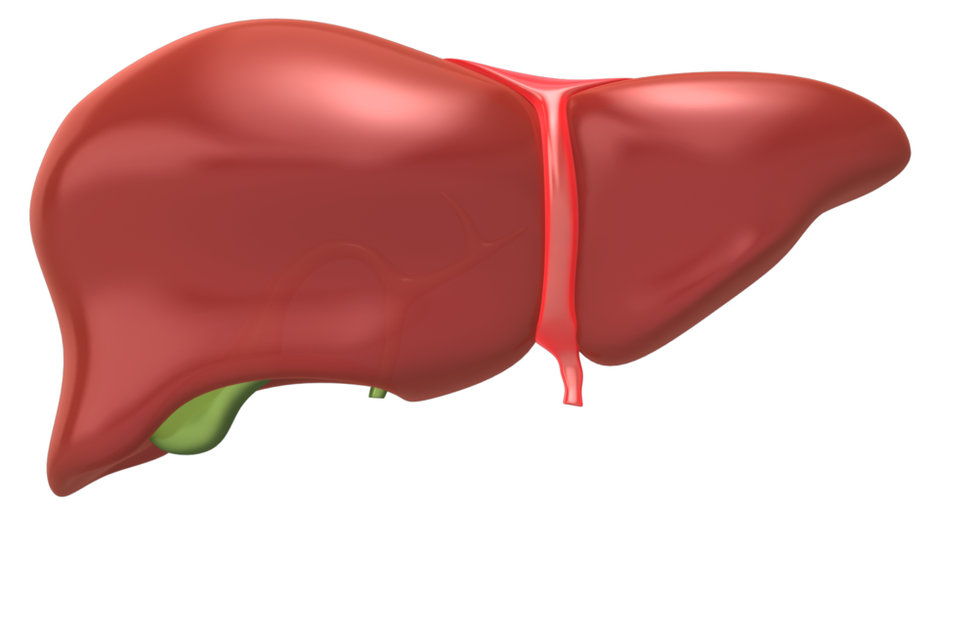
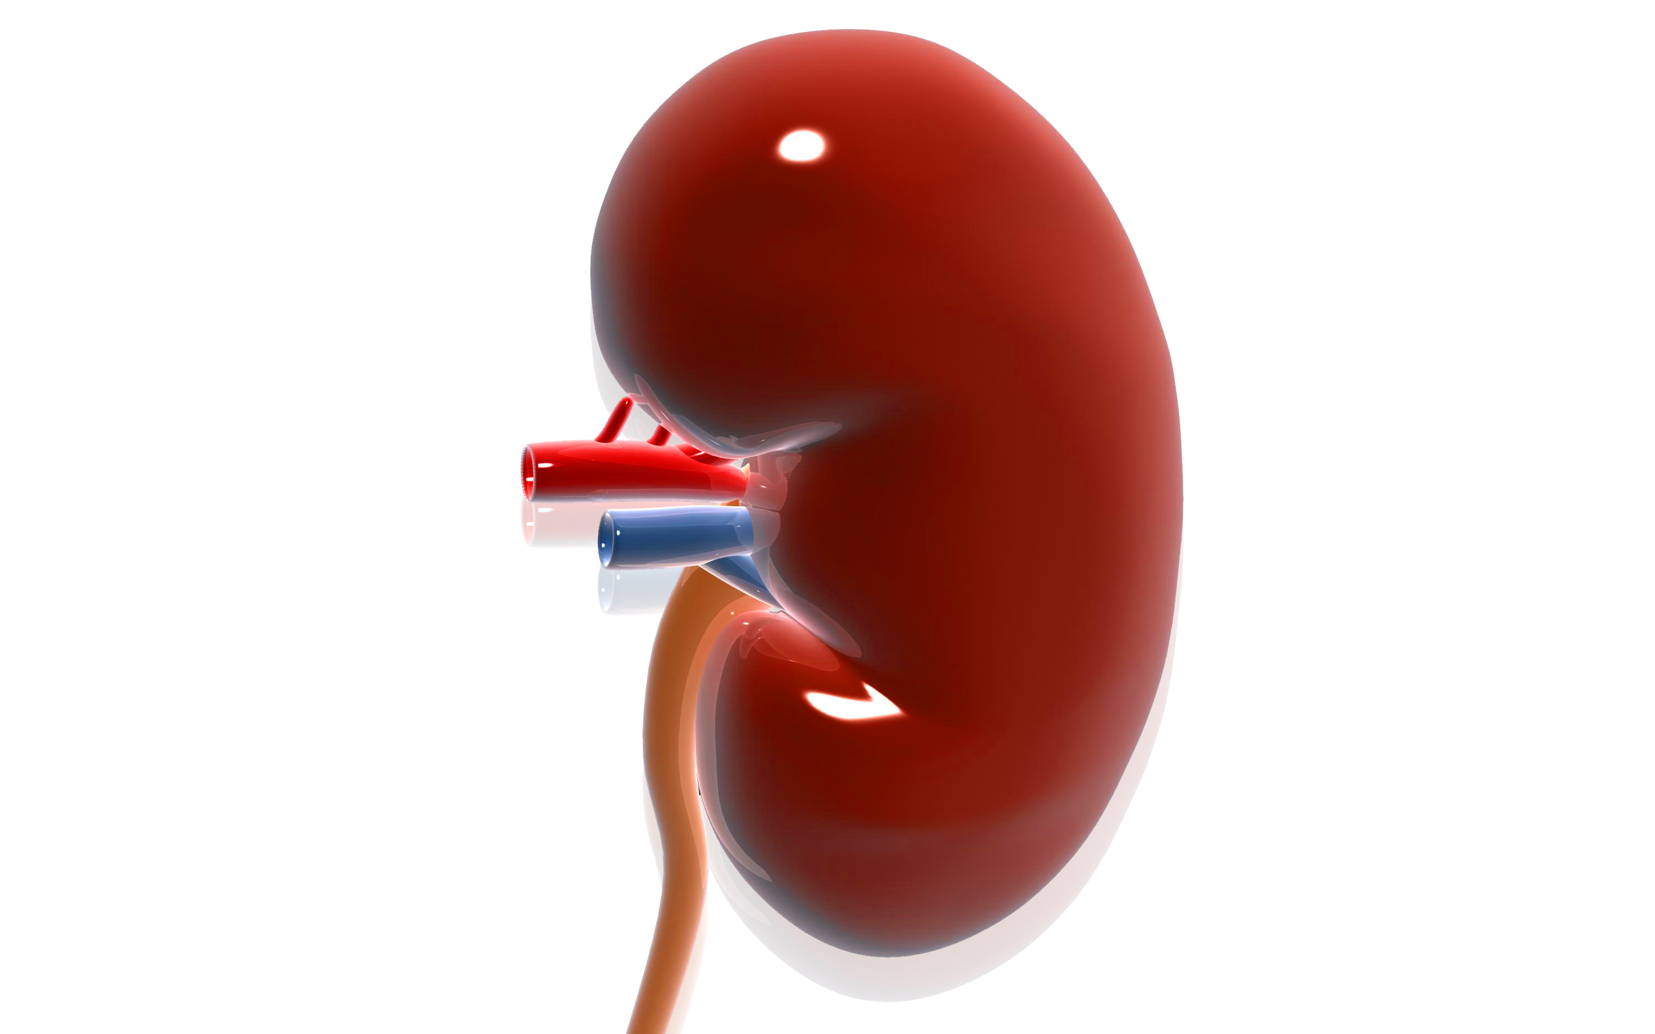
Pharmacokinetic Characteristics and Primary Routes of Clearance of Oral Anticoagulant Agents
Warfarin
Apixaban
Dabigatran
0% Renal elimination
25% Renal elimination
20% Hepatic elimination
100% Hepatic elimination
75% Hepatic elimination
Edoxaban
Rivaroxaban
80% Renal elimination
50% Hepatic elimination
65% Hepatic elimination
35% Renal elimination
50% Renal elimination
In this figure, the size of the liver or kidney denotes the extent of the organ’s contribution to the clearance of the anticoagulant agent
Qamar A et al. Oral Anticoagulation in Patients with Liver Disease. J Am Coll Cardiol 2018;71:2162-2175
Notes:
Speaker Notes:
All DOACs undergo some degree of hepatic metabolism.
Any decrease in liver function could influence the effect of these drugs.

Slide 57
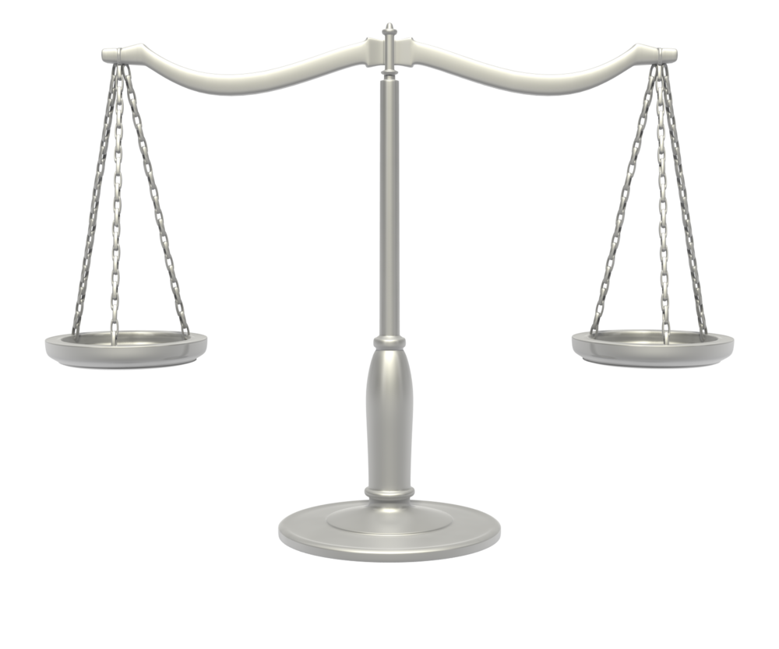
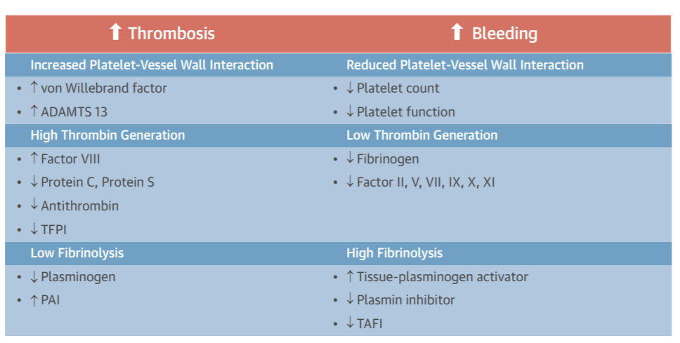
Mechanisms Driving Increased Thrombosis and Bleeding in Liver Disease
ADAMTS 13 ¼ a disintegrin and metalloprotease with thrombospondin type 1 motif 13; PAI ¼ plasminogen activator inhibitor; TAFI ¼ thrombin-activatable fibrinolysis
inhibitor; TFPI ¼ tissue factor pathway inhibitor.
Qamar A et al. Oral Anticoagulation in Patients with Liver Disease. J Am Coll Cardiol 2018;71:2162-2175
Notes:
Speaker Notes:
Patients with liver disease face a heightened risk of thrombotic events that carry a worse prognosis than in patients with normal liver function.
They may also be at increased bleeding risk through a variety of mechanisms as depicted. This risk may be compounded by delayed metabolism of DOACs in this setting.

Slide 58
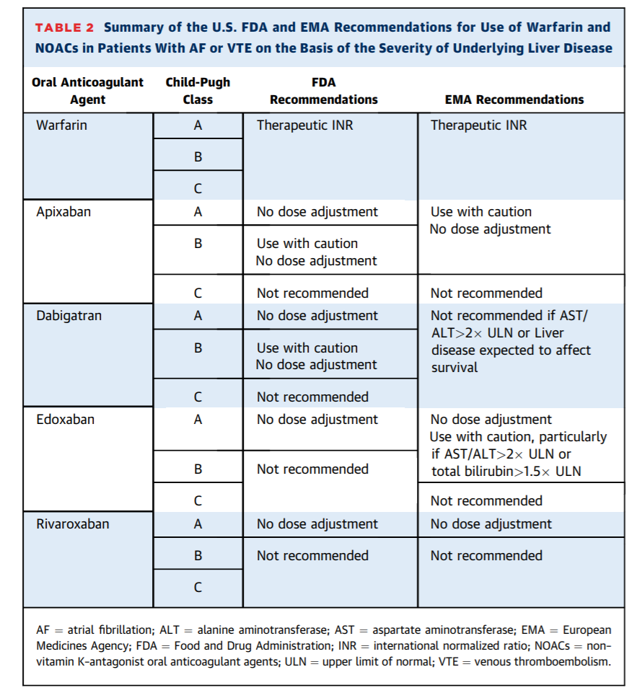
Summary of the U.S. FDA and EMA Recommendations for Use of Warfarin and DOACs in Patients With AF or VTE on the Basis of the Severity of Underlying Liver Disease
Qamar A et al. Oral Anticoagulation in Patients with Liver Disease. J Am Coll Cardiol 2018;71:2162-2175
Notes:
Speaker Notes:
Unlike guidelines for the use of DOACs in renal disease, none of the clinical practice guidelines currently offer any direction regarding the use of these drugs in patients with liver disease.
The basis for the evidence regarding the safety and efficacy of DOACs in patients with impaired liver function predominantly consists of pharmacokinetics studies, case reports, and small observational studies.
Hepatic impairment pharmacokinetic studies have been performed for all currently approved DOACs.
The Child-Pugh score uses the presence of clinical (encephalopathy, ascites) and biochemical (albumin, bilirubin, INR, PT) abnormalities to classify liver disease. Child-Pugh class A, B and C correspond to mild, moderate and severe liver dysfunction and prognosis respectively.

Slide 59
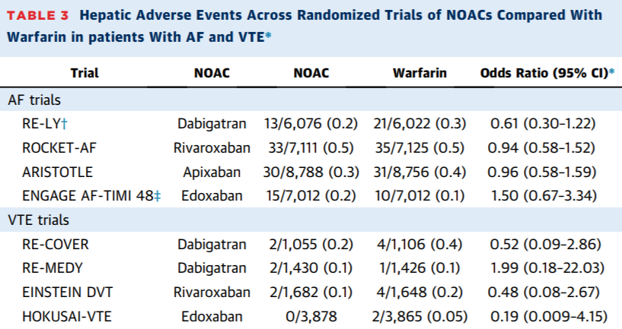
Hepatic Adverse Events Across Randomized Trials of DOACs Compared With Warfarin in patients With AF and VTE*
Qamar A et al. Oral Anticoagulation in Patients with Liver Disease. J Am Coll Cardiol 2018;71:2162-2175
Notes:
Speaker Notes:
No signal of hepatotoxicity has been seen with DOACs within the prospective clinical trials when compared with warfarin.
Since drug-induced liver injury is a rare complication that may require longer treatment duration to manifest (eg. Ximelagatran) , ongoing post-marketing real-world yearly surveillance of LFTs is recommended by some regulatory bodies for patients on long-term DOAC therapy.
The post-marketing data available at this time in DOAC treated patients with or without pre-existing liver disease is reassuring and does not indicate any signal of hepatotoxicity with long-term use of these agents.
Values are n/N (%) unless otherwise indicated. *Hepatic adverse events were defined as alanine aminotransferase or aspartate aminotransferase >3 times upper limit of normal and total bilirubin >2 times upper limit of normal. All are p > 0.20. †These data apply to dabigatran 150 mg twice daily. ‡These data apply to the higher-dose edoxaban regimen. ARISTOTLE ¼ Apixaban for Reduction In STroke and Other ThromboemboLic Events in atrial fibrillation; EINSTEIN DVT ¼ Oral Direct Factor Xa Inhibitor Rivaroxaban in Patients With Acute Symptomatic Deep-Vein Thrombosis; ENGAGE AF-TIMI 48 ¼ Effective Anticoagulation With Factor Xa Next Generation in Atrial Fibrillation-Thrombolysis In Myocardial Infarction Study 48; HOKUSAI-VTE ¼ Comparative Investigation of Low Molecular Weight (LMW) Heparin/Edoxaban Tosylate (DU176b) Versus (LMW) Heparin/Warfarin in the Treatment of Symptomatic Deep-Vein Blood Clots and/or Lung Blood Clots; RE-COVER ¼ Efficacy and Safety of Dabigatran Compared to Warfarin for 6 Month Treatment of Acute Symptomatic Venous Thromboembolism; RE-LY ¼ Randomized Evaluation of Long-term Anticoagulation Therapy; ROCKET-AF ¼ Rivaroxaban Once Daily Oral Direct Factor Xa Inhibition Compared with Vitamin K Antagonism for Prevention of Stroke and Embolism Trial in Atrial Fibrillation; CI ¼ confidence interval;

Slide 60
1
Do DOACs work and are they safe in the elderly and frail?
How do I manage DOACs in the setting of advanced chronic renal failure (CRF) with eGFR < 30 ml/min/173m²?
2
3
Do DOACs retain efficacy at stroke prevention in patients weighing over 120 Kg?
4
Should I reduce the DOAC dosage in the setting of liver failure?
5
Should DOACs be held before implantation of a pacemaker or defibrillator?
6
How should I manage a severe or life-threatening bleed in patients on a DOAC?

Slide 61
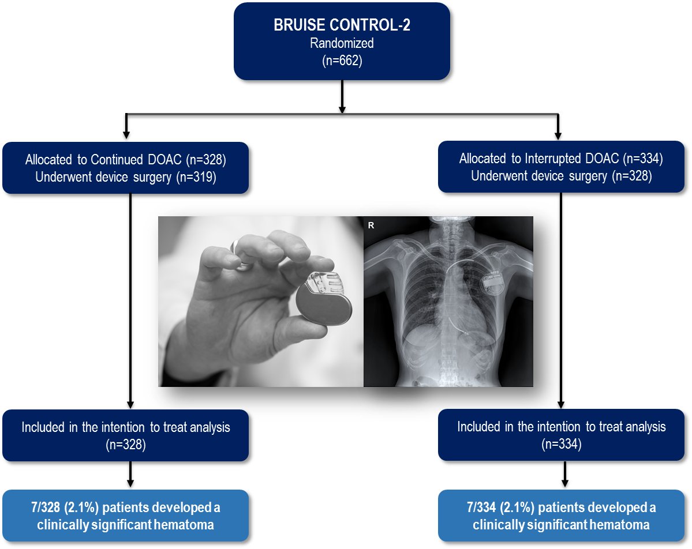
Continued Vs. Interrupted Direct Oral Anticoagulants At The Time Of Device Surgery, In Patients With Moderate To High Risk Of Arterial Thrombo-Embolic Events (BRUISE CONTROL-2)
One Sentence Summary:
This large clinical trial found that pacemaker and defibrillator surgery with either continuation or interruption of a DOAC is association with a low risk of significant wound hematoma. These results suggest that, dependent on the clinical scenario, either management strategy (continued DOAC or interrupted DOAC) might be reasonable.
Birnie DH et al.; European Heart Journal, Volume 39, Issue 44, 21 November 2018, Pages 3973–3979, https://doi.org/10.1093/eurheartj/ehy413
Notes:
Speaker Notes:
Primary Outcome: Clinically significant hematoma (CSH) was defined as:
Hematoma requiring re-operation or
Hematoma resulting in prolongation of hospitalization or
Hematoma requiring interruption of anticoagulation
Abstract
Aims
Guidelines recommend warfarin continuation rather than heparin bridging for pacemaker and defibrillator surgery, after the BRUISE CONTROL trial demonstrated an 80% reduction in device pocket haematoma with this approach. However, direct oral anticoagulants (DOACs) are now used to treat the majority of patients with atrial fibrillation. We sought to understand the best strategy to manage the DOACs at the time of device surgery and specifically hypothesized that performing device surgery without DOAC interruption would result in a reduced haematoma rate.
Methods and results
We randomly assigned patients with atrial fibrillation and CHA₂DS₂-VASc score ≥2, to continued vs. interrupted DOAC (dabigatran, rivaroxaban, or apixaban). The primary outcome was blindly evaluated, clinically significant device pocket haematoma: resulting in re-operation, interruption of anticoagulation, or prolonging hospital stay. In the continued arm, the median time between pre- and post-operative DOAC doses was 12 h; in the interrupted arm the median time was 72 h. Clinically significant haematoma occurred in of 7 of 328 (2.1%; 95% CI 0.9–4.3) patients in the continued DOAC arm and 7 of 334 (2.1%; 95% CI 0.9–4.3) patients in the interrupted DOAC arm (P = 0.97). Complications were uncommon, and included one stroke and one symptomatic pericardial effusion in each arm.
Conclusions
These results suggest that, dependent on the clinical scenario, either management strategy (continued DOAC or interrupted DOAC) might be reasonable, at least for patients similar to those enrolled in our trial.

Slide 62
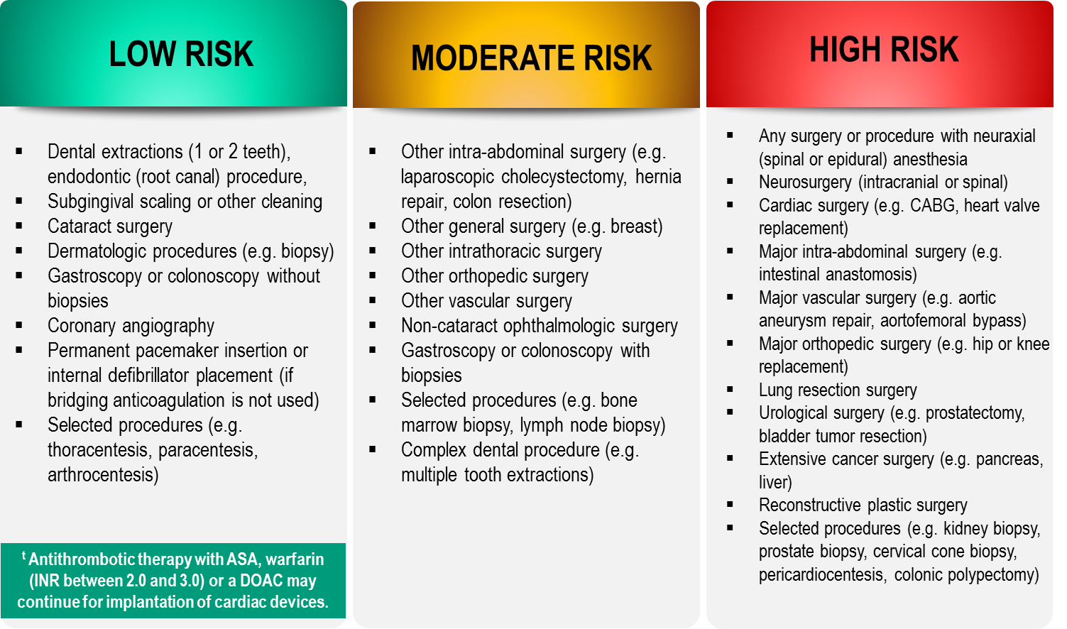
Bleeding Risks for Invasive /
Surgical Procedures
CCS AF Guidelines. Can J Cardiol. 2016; 32: 1170-1185
Thrombosis Canada Clinical Guide. Warfarin: Peri-Operative Management. www.thrombosiscanada.ca
BRUISE-CONTROL 2 – Presented at the AHA Scientific Sessions, Anaheim CA - Nov 2017
Notes:
Speaker Notes:
Steering committee recommendation; In addition to the bleeding risk of a procedure, physicians should consider co-morbid conditions that might exacerbate the bleeding risk (e.g. advanced age, renal or liver impairment).
Many invasive and surgical procedures carry but a very low to low risk of bleeding – DOACs may be held only briefly or even continued without interruption during such procedures as will be discussed in case #2
Antithrombotic therapy with warfarin but not a DOAC can be safely continued pre-post pacemaker or ICD insertion
DOACs never need to be bridged with subcutaneous heparin peri-invasive or surgical procedures due to their short duration of action
REFERENCES:
Douketis JD, Spyropoulos AC, Spencer FA, et al. Perioperative management of antithrombotic therapy: Antithrombotic Therapy and Prevention of Thrombosis, 9th ed: American College of Chest Physicians Evidence-Based Clinical Practice Guidelines. Chest. 2012;141(2 Suppl):e326S - 50S.
Verma A, Cairns JA, Mitchell LB, et al. 2014 focused update of the Canadian Cardiovascular Society
Guidelines for the management of atrial fibrillation. Can J Cardiol. 2014;30(10):1114-1130.
Horlocker TT, Wedel DJ, Rowlingson JC, et al. Regional anesthesia in the patient receiving antithrombotic or thrombolytic therapy: American Society of Regional Anesthesia and Pain Medicine Evidence-Based Guidelines (Third Edition). Reg Anesth Pain Med. 2010;35(1):64-101.
XARELTO-PM-ENG-10JUL2014-172618.pdf. http://www.bayer.ca/files/XARELTO-PM-ENG-10JUL2014-
172618.pdf? Accessed 11 Nov 2014
Pfizer Canada Inc Eliquis Product Monograph. http://www.pfizer.ca/en/our_products/products/monograph/313. Accessed 11 Nov 2014
Boehringer Ingelheim Canada Ltd. (2014) Pradaxa Product Monograph. http://www.boehringer- ingelheim.ca/content/dam/internet/opu/ca_EN/documents/humanhealth/product_monograph/Prad axaPMEN.pdf. Accessed 11 Nov 2014
Thrombosis Canada. http://thrombosiscanada.ca/

Slide 63
1
Do DOACs work and are they safe in the elderly and frail?
How do I manage DOACs in the setting of advanced chronic renal failure (CRF) with eGFR < 30 ml/min/173m²?
2
3
Do DOACs retain efficacy at stroke prevention in patients weighing over 120 Kg?
4
Should I reduce the DOAC dosage in the setting of liver failure?
5
Should DOACs be held before implantation of a pacemaker or defibrillator?
6
How should I manage a severe or life-threatening bleed in patients on a DOAC?

Slide 64


Treatment of a Major Bleed on a DOAC
Basic Principles
Resuscitate (IV hydration, oxygen)
Identify source and control bleeding (packing, compress, cauterize)
Stop the DOAC (vs. risk of thrombosis)
Transfuse appropriate blood products (packed rbc’s, platelets, FFP) Activated charcoal gastric lavage
If overdose suspected within previous 2-3 hours
Hemodialysis
Dabigatran, because of low 35% protein binding
Tomaselli GF, Mahaffey KW, Cuker A, et al. 2017 ACC Expert Consensus Decision Pathway on Management of Bleeding in Patients on Oral Anticoagulants: A Report of the American College of Cardiology Task Force on Expert Consensus Decision Pathways. J Am Coll Cardiol 2017;Dec 1
Notes:
Speaker Notes:

Slide 65
Treatment of a Major Bleed on a DOAC
Hemostatic Agents
Antifibrinolytic drugs
Aminocaproic acid (Amicar™)
Tranexamic acid (Cyclokapron™)
Prothrombotics drugs (with a risk of causing thrombosis…)
PCCs (Octaplex™, Beriplex™)
aPCCs (FEIBA™)
rFVIIa (NovoSeven™, Niastase™)
Cryoprecipitate
Desmopressin (DDAVP)
Fresh frozen plasma (FFP)
Tomaselli GF, Mahaffey KW, Cuker A, et al. 2017 ACC Expert Consensus Decision Pathway on Management of Bleeding in Patients on Oral Anticoagulants: A Report of the American College of Cardiology Task Force on Expert Consensus Decision Pathways. J Am Coll Cardiol 2017;Dec 1
Notes:
Speaker Notes:

Slide 66
Treatment of a Major Bleed on a DOAC
Reversal Agents (Antidotes)
Circumstances when an antidote may be useful:
Polytrauma
CVA requiring thrombolysis
Urgent surgery
Overdose
Idarucizumab (Praxbind™)
Humanized antibody fragment (FAB)
Removes dabigatran from circulation
Dosage: 5 g
TT normalized in 15 minutes (never administer if TT already normal…)
5% reported thrombotic events at one month
Andaxanet Alfa (AndexXa™)
Inert facteur Xa (decoy) with sequestration of any anti-Xa in circulation (Rivaroxaban – Apixaban – Edoxaban)
Approved by the FDA in May 2018 but not as of yet by Health Canada…
Tomaselli GF, Mahaffey KW, Cuker A, et al. 2017 ACC Expert Consensus Decision Pathway on Management of Bleeding in Patients on Oral Anticoagulants: A Report of the American College of Cardiology Task Force on Expert Consensus Decision Pathways. J Am Coll Cardiol 2017;Dec 1
Notes:
Speaker Notes:

